Slide 1





School Response Program
a Georgia Stop the Bleed initiative
Notes:
Georgia Specific Slide
Note to instructor: Other following introductory slides are specific to Georgia’s school-based “Stop the Bleed” initiatives. We’ve included a number of optional (“hidden”) slides to assist you with your presentation.
The Stop the Bleed initiative is a joint effort provided by the Georgia Trauma Commission, Georgia Trauma Foundation, Georgia Committee on Trauma, and the American Collage of Surgeons.

Slide 2
Enter Name
Region ?
Regional Trauma Advisory Committee
contact@email.com
Billy Kunkle
Georgia Trauma System Planner
Georgia Trauma Commission
billy@gtcnc.org
Notes:
Georgia Specific Slide
Note to instructor: Optional Slide – To utilize, update with presenter(s) information and right click on slide icon to the left to unhide.

Slide 3
Special Thanks To:
Albany State University
Alma-Bacon County EMA
Archbold Medical Center
Atikinson County EMA
Bacon County Fire EMS
Brooks County Hospital
Catossa County Sherriff’s Office
Central Georgia Medical Reserve Corps
DeKalb County EMA
Dorminy Medical Center
Georgia Department of Public Health
Georgia Emergency Management Agency
Grady EMS
Gwinnett County Fire and EMS Academy
Hope EMS
Jasper County Fire EMS
Jasper County Sherriff’s Office
Liberty County EMS
Medical Center Navicent Health
Office of EMS and Trauma
Region 8 RTAC
South Georgia Medical Center EMS
South Georgia State College
Tift County Fire Rescue
Tift Regional Medical Center
Whitfield County Schools
All of Our Awesome Volunteers!
Notes:
Georgia Specific Slide
Note to instructor: Optional Slide – To utilize updated with list of volunteer and contributing organizations then right click on slide icon to the left to unhide..

Slide 4
Program Highlights
The Stop the Bleed - School Response Program is designed to enable you to render immediate, potentially life-saving medical aid to injured students or co-workers while you await the arrival of professional responders.
Notes:
Georgia Specific Slide
Note to instructor: Program Highlights - The Stop the Bleed - School Response Program is designed to enable you to render immediate, potentially life-saving medical aid to injured students or co-workers while you await the arrival of professional responders.

Slide 5
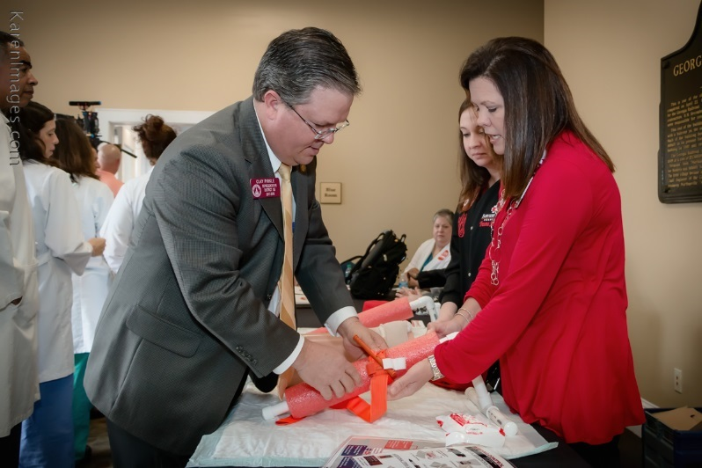

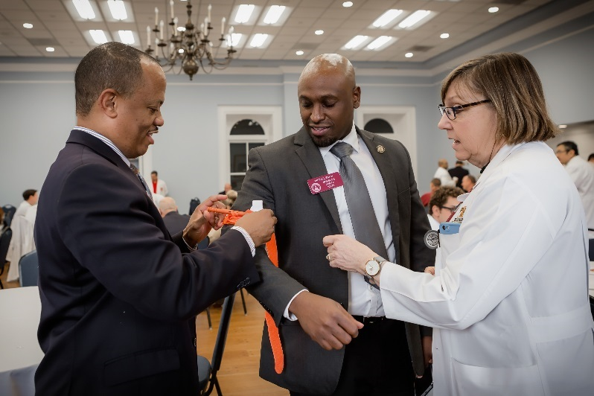

How did we get here?
February 7, 2017
  Trauma professionals from across the state lobbied state law-makers to enable us to provide the Stop the Bleed program in the public school systems across Georgia.
The “Ask”
  Additional $1M for Georgia Trauma Commission’s budget to support initiative
March 23, 2017
  Additional funding approved!
Kits and Training
  Over 29,000 Bleeding Control Kits purchased to distribute and provide life-saving education to over 2,000 schools.
Notes:
Instructors may find it also useful to share that the Georgia Trauma Commission is funded by Super Speeder funds.

Slide 6
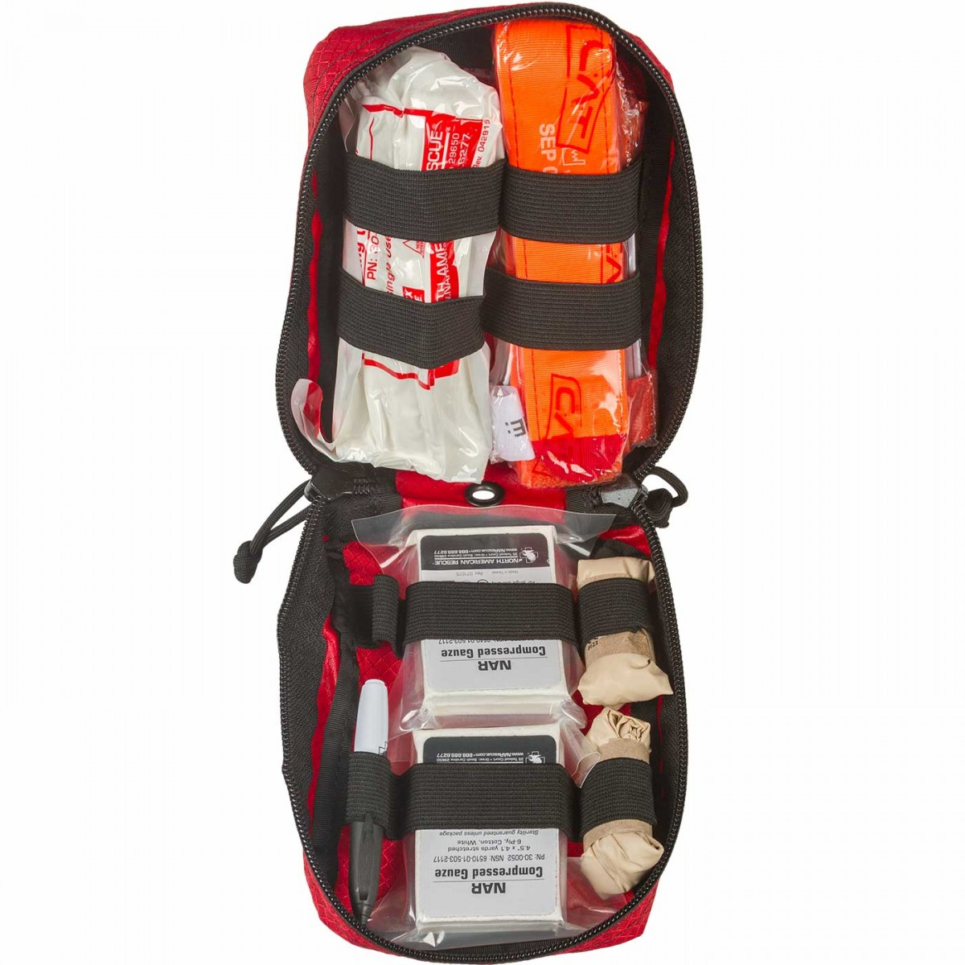
Bleeding Control Kit Components
2 – Pair of Nitrile Gloves
1 – C-A-T Tourniquet
2 – Compressed Gauze
1 – 6” Emergency Trauma Dressing
1 – Trauma Shears
1 – 5”x9” Trauma Pad
1 – 2” Roll of Tape
1 – English/Spanish Instruction Card
Notes:
Georgia Specific Slide
Note to instructor: Bleeding Control Kit Components
Nitrile Gloves (2 pair)
C-A-T Tourniquet
Compressed Gauze (x2)
6” Emergency Trauma Dressing
Trauma Shears
5”x9” Trauma Pad
Tape
English/Spanish Instructions

Slide 7


Bleeding Control (B-Con)
Basic
Copyright © 2017 by the American College of Surgeons
Notes:
Note to instructor: This presentation includes the slide set you will need in order to deliver the didactic portion of the Bleeding Control Basic (B-Con) course as well as instructor notes to assist you with the delivery of this material. Consider downloading and printing the “Bleeding Control Booklet” as a handout for course participants.

Slide 8
What everyone should know to
control bleeding
Bleeding Control Basic v. 1.0

Slide 9

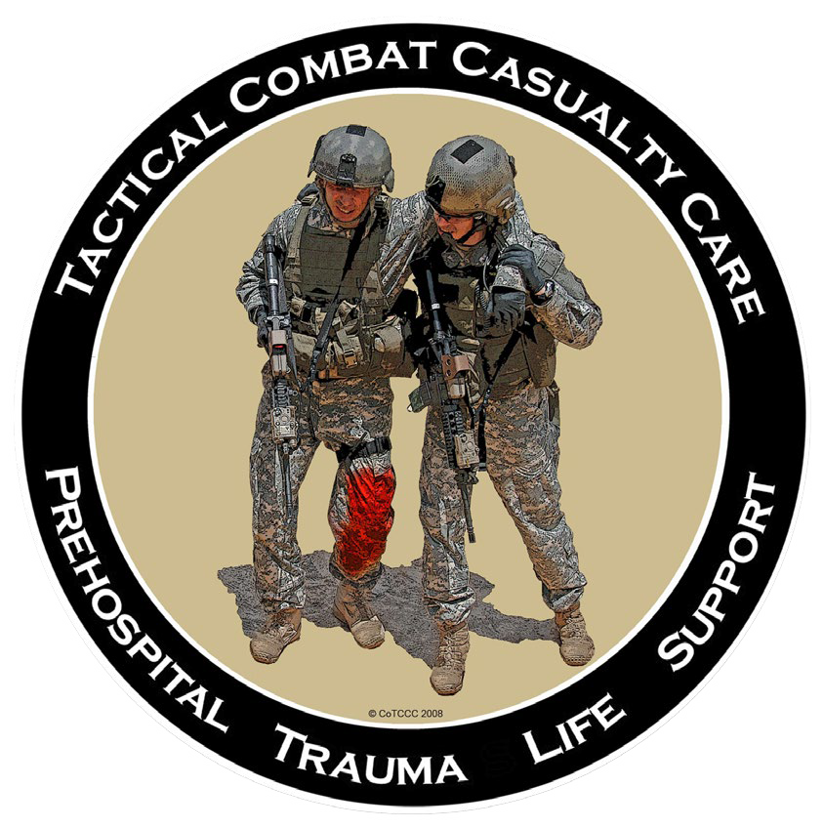

This educational program is the product of a cooperative effort by:
The National Association of
Emergency Medical Technicians
The Hartford
Consensus
The American
College of Surgeons Committee on Trauma
The Committee on Tactical Combat Casualty Care
Notes:
This educational program represents the collaborative effort of many organizations.
It represents the current “best practice” recommendations for how to manage life-threatening hemorrhage.

Slide 10
The focus of this program is on:
The immediate response to bleeding
Recognize life-threatening bleeding
Appropriate ways to stop the bleeding
The help given by an immediate responder can often make the difference between life and death, even before professional
rescuers arrive.
With the right training, YOU can help save lives!
Notes:
One of the most common causes of preventable death after traumatic injury is uncontrolled bleeding.
Everyone should know how to recognize life-threatening bleeding.
Everyone should be able to take the appropriate steps to control bleeding until help arrives.

Slide 11

WARNING! Some of the images shown during this presentation are graphic
and may be disturbing to some people.
Notes:
This course was designed to teach you how to recognize and control life-threatening hemorrhage. We can’t do that without clinical photographs that are relevant to the course content. Some of these photographs are graphic in nature and may be disturbing to some individuals.

Slide 12
Why Do I Need This Training?
Work-related injuries
Mass
shootings
Home injuries
Motor vehicle crashes
Bombings
Notes:
Many injury mechanisms can result in serious bleeding.
While mass shootings currently get a lot of attention, serious bleeding is more likely to result from everyday injuries such as those that may occur at home, at work or while on the road.

Slide 13
Primary Principles of Immediate Response
Ensure your own safety
The ABCs of Bleeding
A – Alert – call 9-1-1
B – Bleeding – find the bleeding injury
C – Compress – apply pressure to stop the bleeding by:
  Covering the wound with a clean cloth and applying pressure by pushing directly on it with both hands, OR
  Using a tourniquet, OR
  Packing (filling) the wound with gauze or a clean cloth and then applying pressure with both hands
Notes:
These are the basic principles that should govern your response if you find yourself in one of these situations:
- First, make sure the scene is safe. You must ensure your own safety before trying to help someone else.
- Next, get help. Call or have someone call 9-1-1 for assistance. Make every effort to assure help is on the way as you proceed to the next step.
- Look for the site of bleeding. The site of the bleeding will frequently dictate how you will need to control it.
- Once you have located the source, control of the bleeding will involve the application of direct pressure, the placement of a tourniquet, the packing of an open wound or a combination of all of these techniques.
We will discuss each of these points in more detail in coming slides.

Slide 14
Safety
Primary Principles:
Before you offer any help, you must remain safe
If you become injured, you will not be able to help the victim
Initiate care if the scene is safe for you to do so
If, at any time, your safety is threatened, attempt to remove yourself from danger and find a safe location
Protect yourself from blood-borne infections by wearing gloves, if available
Notes:
Your personal safety is an important consideration. If you become injured as well, you won’t be able to help anyone and the situation you find yourself in becomes more complicated. If the scene in not safe for whatever reason, you should remove yourself (and the victim, if possible) from danger and try to find a safe location. Once you reach safety, you can focus on bleeding control.
Exposure to an injured patient’s blood or other body fluids is another safety consideration. Blood-borne pathogens are germs that could be spread through exposure to someone else’s blood. If you have access to bleeding control supplies, you should also have access to protective gloves.
If these supplies are not available to you, wash your hands thoroughly after touching a victim and ask EMS personnel about appropriate blood cleanup procedures.

Slide 15
ABCs of Bleeding
Primary Principles:
A • Alert
Get help
Call 9-1-1 yourself, OR
Tell someone to call 9-1-1
Alerting 9-1-1 will notify and get emergency medical responders and, depending on the situation, police officers to respond to the scene
Notes:
Calling your local emergency services is one of the most important actions you can take when someone is injured.
This will start the process of getting trained responders to the incident location.
It is critical, therefore, that you make every effort to call 9-1-1 or direct someone at the scene to do so as soon as and whenever possible.
This is also extremely important when the situation involves any criminal activity as it will also initiate a police response to the scene.

Slide 16
ABCs of Bleeding
Primary Principles:
B • Bleeding
Find where the victim is bleeding from
Open or remove the clothing so you can see the wound
Look for and identify “life-threatening” bleeding
Blood that is spurting out of the wound
Blood that won’t stop coming out of the wound
Blood that is pooling on the ground
Clothing that is soaked with blood
Bandages that are soaked with blood
Loss of all or part of an arm or leg
Bleeding in a victim who is now confused or unconscious
Notes:
The sooner the bleeding site is controlled, the better the chances of survival.
The purpose of this course is to empower the immediate responder to take action as soon as possible while trained help is responding.
The first step is to identify the source of the bleeding. This requires a careful inspection to identify the site of bleeding. In some cases, the source of blood loss is obvious. In other cases, you may need to open or remove clothing to find the injury.
Once the wound has been located, you must determine if the bleeding is life-threatening or not.
Examples of what “life-threatening” bleeding may look like are outlined on this slide.

Slide 17
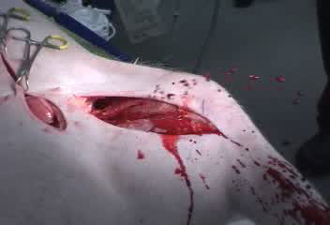
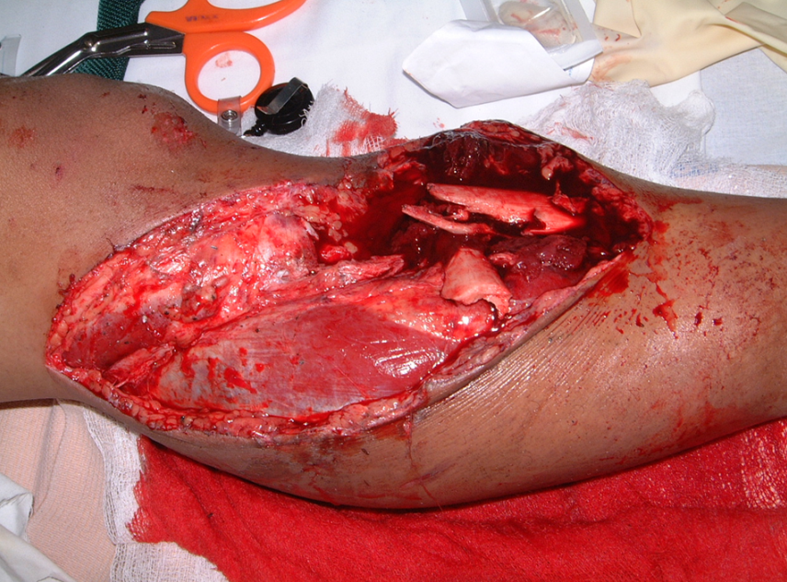
ABCs of Bleeding
Primary Principles:
B • Bleeding (continued)
What is “life-threatening” bleeding?
Blood spurting out of a wound
Blood soaking the sheet or clothing
Photo courtesy of Norman McSwain, MD, FACS, NREMT-P.
Notes:
Here are two illustrations of potentially life-threatening bleeding.
- On the left, you see blood that is spurting or pumping out of the wound.
- On the right, you see a large injury to an extremity with blood soaking the sheet underneath.

Slide 18
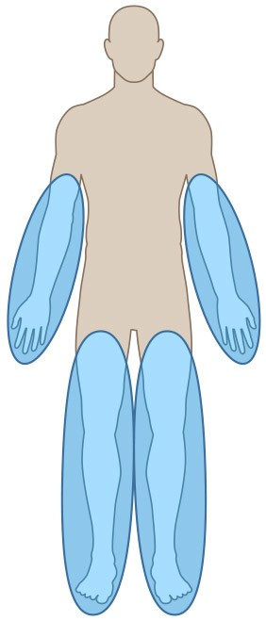
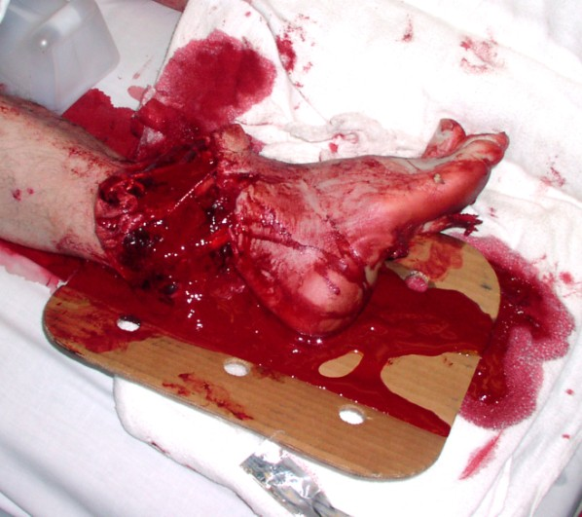
ABCs of Bleeding
Primary Principles:
B • Bleeding (continued)
Wounds That Can Lead to Death from Bleeding (1 of 3)
Arm and Leg Wounds
Most frequent cause of preventable
death from injury
Bleeding from these wounds can be controlled by direct pressure or a
tourniquet
Photo courtesy of Peter T. Pons, MD, FACEP.
Notes:
Let’s talk more about wounds that can cause death due to bleeding.
Bleeding from wounds located on the arms or the legs can usually be controlled by applying direct pressure on the wound itself or by placing a tourniquet on the arm or leg above the wound and tightening it until the bleeding stops.
The photograph on the right is of a patient with a near complete amputation of the lower leg that resulted from a car crash.
Bleeding from extremity wounds should be controllable and are a major focus of this training.

Slide 19
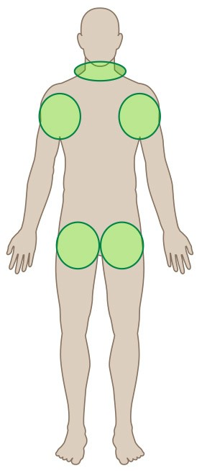
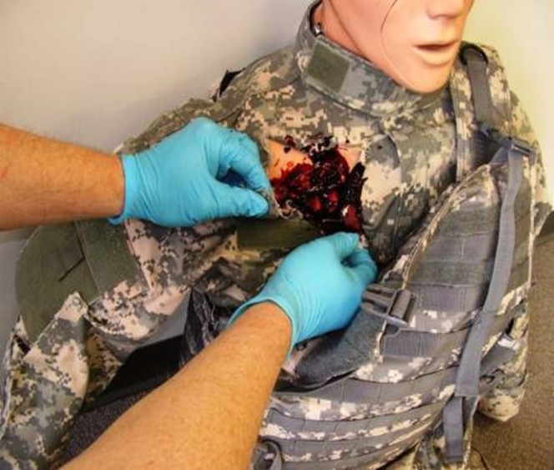
ABCs of Bleeding
Primary Principles:
B • Bleeding (continued)
Wounds That Can Lead to Death from Bleeding (2 of 3)
Torso Junctional Wounds
Neck, shoulder, and groin
Bleeding can be controlled by direct pressure and wound packing
Notes:
Injuries to the groin, shoulder/armpit, and neck are often referred to as junctional wounds.
This is where the arms, legs, and head join with the torso, hence the name junctional.
These are common injuries in armed conflicts, but they can also occur as a result of bombings as was noted following the Boston Marathon in 2013.
Fortunately, these events and injuries are not common.
A tourniquet cannot be applied in these locations and a different management approach to active bleeding is required.
In order to control bleeding from these anatomic locations, you need to pack or fill the wound and then apply direct pressure.

Slide 20
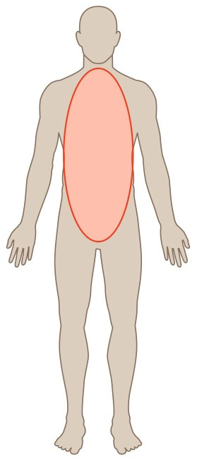
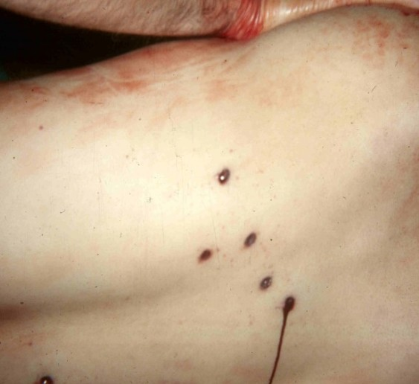
ABCs of Bleeding
Primary Principles:
B • Bleeding (continued)
Wounds That Can Lead to Death from Bleeding (3 of 3)
Chest and Abdominal Injuries
Front, back, or side
Usually cause internal bleeding
This bleeding CANNOT be stopped outside the hospital
These victims need rapid transport to a trauma center
Identify these patients to EMS providers when they arrive
Multiple gunshot wounds
Photo courtesy of Peter T. Pons, MD, FACEP.
Notes:
Wounds located on the chest or abdomen (front, side, or back) can be associated with internal bleeding.
You cannot control internal bleeding outside the hospital setting.
The most important action you can take in these cases is to quickly recognize the potential for internal bleeding and to call 9-1-1. Make sure to alert the first responders about any wounds you may have identified.
In cases where multiple victims are injured at one time, concern for internal bleeding is an important triage concern and these patients will frequently be transported to the hospital before patients with more controllable sources of bleeding.

Slide 21
ABCs of Bleeding
Primary Principles:
C • Compression: Stop the Bleeding
Ensure your safety.
Look for life-
Is a trauma first-aid kit available?
threatening bleeding.
Notes:
Let’s now focus on how to control hemorrhage when a bleeding control kit is not available. In these cases, you need to improvise.
The first priority is to make sure that the scene is safe, as discussed earlier.
Search for the site of bleeding and determine if it may be life threatening.
Determine if any bleeding control supplies are available to you….

Slide 22
ABCs of Bleeding
Primary Principles:
C • Compression: Stop the Bleeding
Look for life-
Is a trauma first-aid kit available?
No
Ensure your safety.
threatening bleeding.
Introduction | Principles | A-Alert | B-Bleeding | C-Compression |
Notes:
If the answer is no…..

Slide 23
ABCs of Bleeding
Primary Principles:
C • Compression: Stop the Bleeding

Use any clean cloth or gauze.

Apply steady pressure directly on the wound.
Look for life-
Is a trauma first-aid kit available?
No
Ensure your safety.
threatening bleeding.
Notes:
You can control bleeding by taking any available cloth or gauze and using it to apply pressure directly to the bleeding wound. Controlling the hemorrhage is more important than concern for sterility at this stage.
You do not need to have the specialized supplies that are part of a bleeding control kit to save a life. The rapid application of direct pressure to a bleeding wound is a life-saving maneuver until help arrives.

Slide 24
ABCs of Bleeding
Primary Principles:
C • Compression: Stop the Bleeding (continued)
Direct Pressure (1 of 3)
Use your hand or fingers
  Use two hands, if at all possible
Effective most of the time for external bleeding
  Direct pressure can stop even major arterial bleeding
Bleeding control requires very firm, continuous pressure until relieved by medical responders
To be effective, apply pressure with the victim on a firm surface to provide support
Don’t release pressure to check the wound
Notes:
Direct pressure can control bleeding from anywhere on the body. A firmly applied pair of hands placed directly onto a bleeding wound can control arterial bleeding, even from large blood vessels, such as those in the neck and groin.
Remember you must hold pressure until you are relieved by the medical responders arriving to the scene.
You should not release the pressure to see how well it is working. Just keep pushing firmly on the wound to control the bleeding.
Applying pressure to a bleeding wound is a painful procedure and will hurt the victim but it is necessary in order to stop the bleeding.

Slide 25
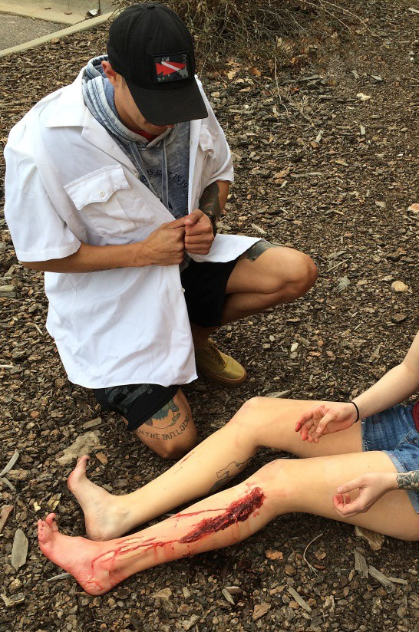
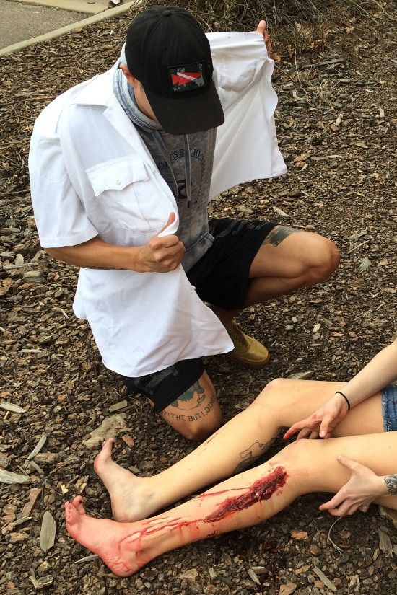
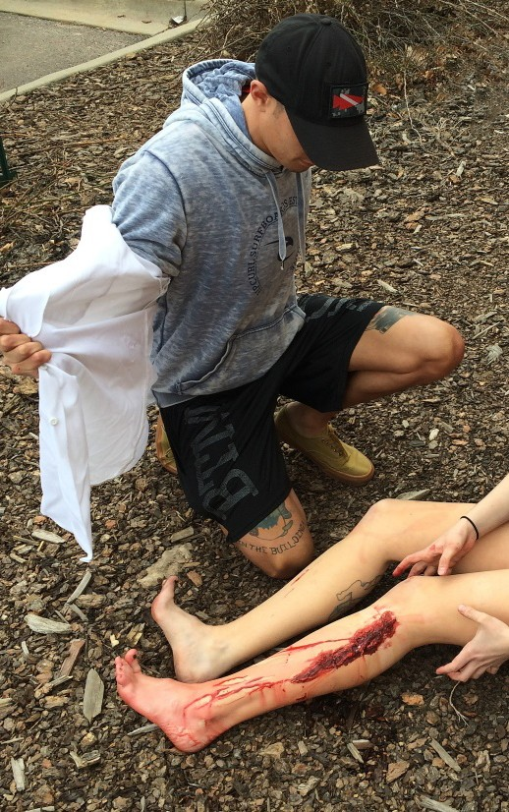
ABCs of Bleeding
Primary Principles:
C • Compression: Stop the Bleeding (continued)
Direct Pressure (2 of 3)
Use any clean cloth (for example, a shirt) to cover the wound
If the wound is large and deep, try to “stuff” the cloth down into the wound
Photos courtesy of Adam Wehrle, NREMT-P.
Notes:
This series of photos demonstrates the procedure.
In this case, the immediate responder is using his shirt.
If the wound is really large and deep, you can “stuff” or “pack” the wound with the cloth.
This will get the cloth deep down into the wound where it is bleeding and helps transmit the pressure you apply to the depths of the wound to better control the bleeding.

Slide 26
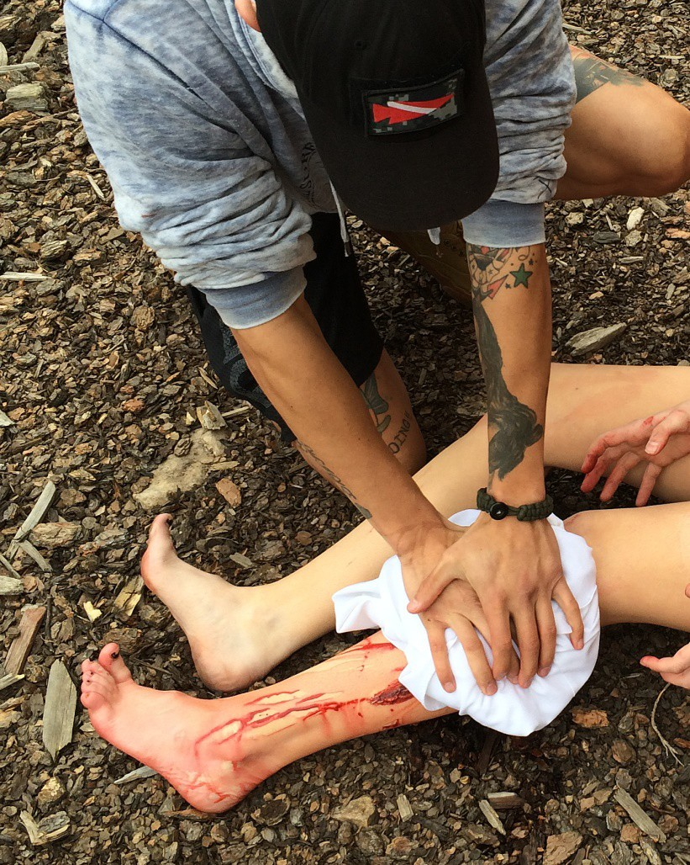
ABCs of Bleeding
Primary Principles:
C • Compression: Stop the Bleeding (continued)
Direct Pressure (3 of 3)
Apply continuous pressure with both hands directly on top of the bleeding wound
Push down as hard as you can
Hold pressure until relieved by medical responders
Photo courtesy of Adam Wehrle, NREMT-P.
Notes:
Once you have either covered the wound or “packed” the wound, you must apply continuous pressure right on the wound using both of your hands. This means pushing down on the wound as hard as you can.
It is important to understand that if the victim is awake, both packing the wound and applying direct pressure will hurt a lot.
Talk to the victim and explain what you are doing as you are doing it and let them know this will help stop their bleeding. They are bleeding and you are working to save their life.

Slide 27
ABCs of Bleeding
Primary Principles:
C • Compression: Stop the Bleeding (continued)
Ensure your safety.
Look for life-
Is a trauma first-aid kit
threatening bleeding.
available?
Yes
Notes:
Now, let’s discuss how to proceed when a bleeding control kit is available. Bleeding control kits come in many shapes and sizes, but they usually contain at least a tourniquet and some other basic essential supplies needed to control bleeding.
These kits are becoming more common in public areas. There is an effort to locate them near AED devices in public spaces.
As a student in this course, you should start looking for these kits in public places. You can also suggest purchase and installation of these kits in places you frequent such as schools, cafeterias and other public gathering areas. These kits are generally not expensive and are easy to install and maintain.
You can be an advocate for the concept of making these simple supplies as readily available as possible. You never know when an action on your part will save a life, or perhaps many lives.

Slide 28
ABCs of Bleeding
Primary Principles:
C • Compression: Stop the Bleeding (continued)
?
Ensure your safety.
Look for life-
Is a trauma first-aid kit
Where is the
threatening bleeding.
wound?
Arm or leg
available?
Yes
Notes:
The first thing we need to determine is the location of the wound.
Is the wound located on an arm or leg?

Slide 29
ABCs of Bleeding
Primary Principles:
C • Compression: Stop the Bleeding (continued)
?
Is a tourniquet available immediately?
Ensure your safety.
Look for life-
Is a trauma first-aid kit
Where is the
threatening bleeding.
wound?
Arm or leg
available?
Yes
Notes:
If the answer is yes…then we need to see if the trauma kit contains a tourniquet.

Slide 30
ABCs of Bleeding
Primary Principles:
C • Compression: Stop the Bleeding (continued)
?
Is a tourniquet available immediately?
Ensure your safety.
Look for life-
Is a trauma first-aid kit
Where is the
threatening bleeding.
wound?
Arm or leg
available?
Yes
Yes
Notes:
If a tourniquet is immediately available………

Slide 31
ABCs of Bleeding
Primary Principles:
C • Compression: Stop the Bleeding (continued)
?
Is a tourniquet available immediately?
Ensure your safety.
Look for life-
Is a trauma first-aid kit
Where is the
threatening bleeding.
wound?
Arm or leg
available?
Yes

Apply above the bleeding site.

Tighten until the bleeding stops.
Yes
Notes:
Place the tourniquet on the injured arm or leg
Be sure it is above the bleeding site.
Tighten the tourniquet until the bleeding stops.

Slide 32
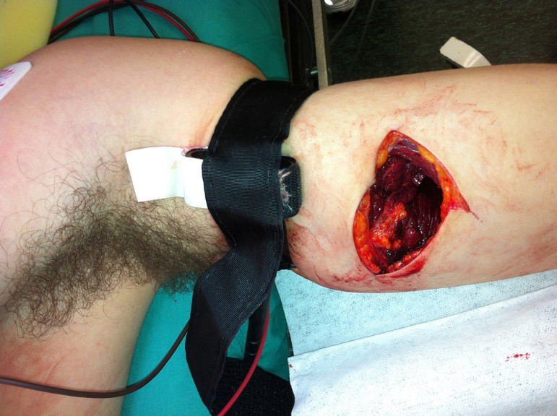
ABCs of Bleeding
Primary Principles:
C • Compression: Stop the Bleeding (continued)
The Tourniquet
A tourniquet is a device that stops the flow of blood
If applied correctly, the tourniquet will stop blood flow into the extremity and out of the wound
Limiting blood loss may prevent the
patient from going into shock or dying
Photo courtesy of Norman McSwain, MD, FACS, NREMT-P.
Notes:
So, let’s talk about modern tourniquets.
Tourniquets are devices that put pressure on blood vessels above the site of a serious wound in order to stop on-going bleeding.
When a tourniquet is properly applied, it will prevent all blood from getting into the injured arm or leg and thus, stop bleeding from the injury.
Excessive bleeding can result in shock. Shock occurs when there is decreased delivery of oxygen and other vital nutrients to the organs of the body. Blood is the main delivery vehicle for these vital substances and the decrease in the amount of functional blood cells in combination with the decreased blood pressure that results from shock can result in permanent organ damage and, eventually, death.

Slide 33
ABCs of Bleeding
Primary Principles:
C • Compression: Stop the Bleeding (continued)
Tourniquet Application
Apply immediately if life-threatening bleeding is seen from an arm or a leg
The tourniquet can be placed right on top of clothing, if necessary
Place 2 to 3 inches above the bleeding wound (higher on the arm or leg)
  BUT…
    DO NOT apply directly over the knee or elbow joints
      The bones of the joint will prevent the tourniquet from compressing the artery, so you won’t stop the bleeding
    DO NOT apply directly over a pocket that contains bulky items
      Anything in a pocket that is underneath a tourniquet will interfere with the function of the tourniquet
Tighten the tourniquet until bleeding stops
Notes:
A recommended commercial tourniquet can be a life-saving device. There should not be any hesitation about using one when there is life-threatening bleeding from an arm or a leg.
Here is a key point about applying a tourniquet: “Above the bleeding site” means farther up on the arm or leg and not on top of the wound.
You can place the tourniquet over the victim’s clothing if time is critical and the situation does not allow you to open up the clothing to find the wound…just be certain that the tourniquet is placed high enough on the extremity so that is it above the location of the wound.
Then, tighten the tourniquet until the bleeding stops.
If you have made the tourniquet as tight as you can and the wound is still bleeding, apply a second tourniquet, if it is available, on the extremity just above the first one.
If a second tourniquet is not available, apply direct pressure on the wound.

Slide 34
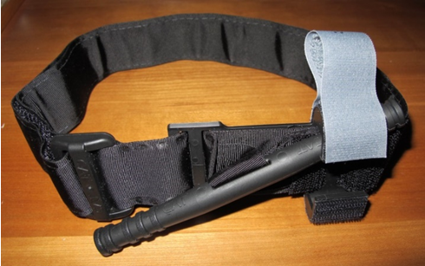
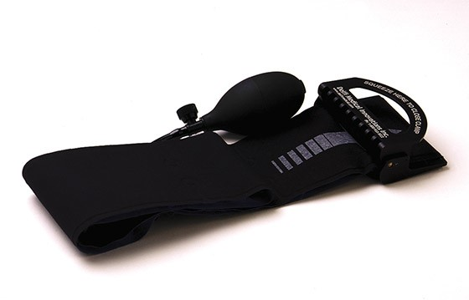
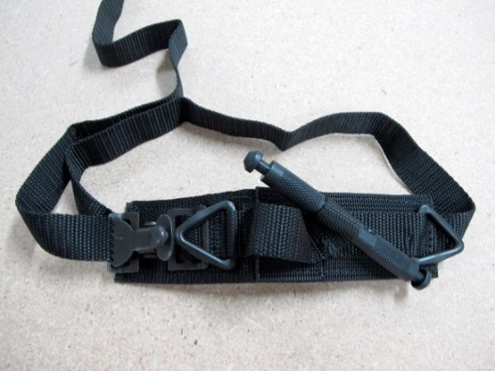
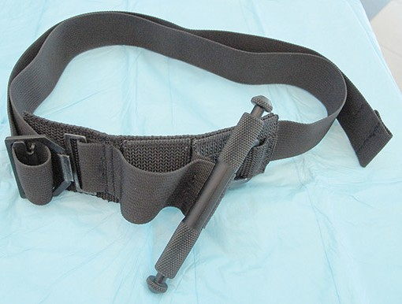
ABCs of Bleeding
Primary Principles:
C • Compression: Stop the Bleeding (continued)
Tourniquet Types
Military research has shown these three tourniquets work the best to control bleeding
Photo courtesy of Peter T. Pons, MD, FACEP
Combat Application Tourniquet (C.A.T.)
Photo courtesy of Delfi Medical Innovations, Inc.
Emergency and Military Tourniquet (EMT™)
1st Generation
2nd Generation
Photo courtesy of Peter T. Pons, MD, FACEP
Photo courtesy of Peter T. Pons, MD, FACEP
SOF Tactical Tourniquet (SOFTT)
Notes:
There are many types of commercially available tourniquets.
The three brands of tourniquets shown is this slide have been studied by the U.S. Army Institute for Surgical Research and have been shown to consistently work the best.
While other tourniquets are available and may be less expensive, these three tourniquets have been carefully evaluated and shown to be effective.

Slide 35
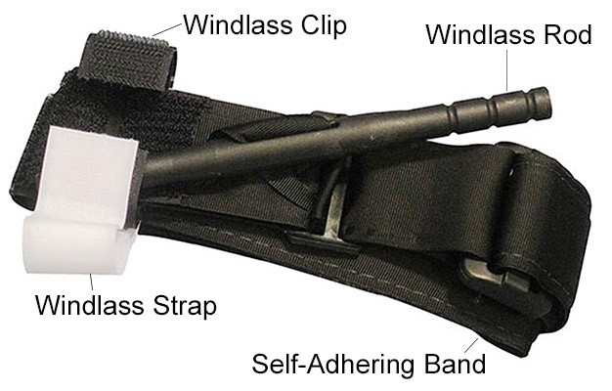
ABCs of Bleeding
Primary Principles:
C • Compression: Stop the Bleeding (continued)
C.A.T. Tourniquet
The C.A.T. tourniquet is the
military’s preferred tourniquet
because it is easy to use and can be rapidly applied
Photo courtesy of Composite Resources, Inc.
Introduction | Principles | A-Alert | B-Bleeding | C-Compression |
Notes:
The C.A.T. tourniquet is the favorite choice of the U.S. military.
It is quite easy to use.
The C-A-TTM uses a self-adhering (VelcroTM type) band and a buckle to fit a wide range of extremities.
The windlass rod uses a internal band to take up the slack and apply pressure around the limb.
The windlass rod is then secured in place with the windlass clip and strap.

Slide 36
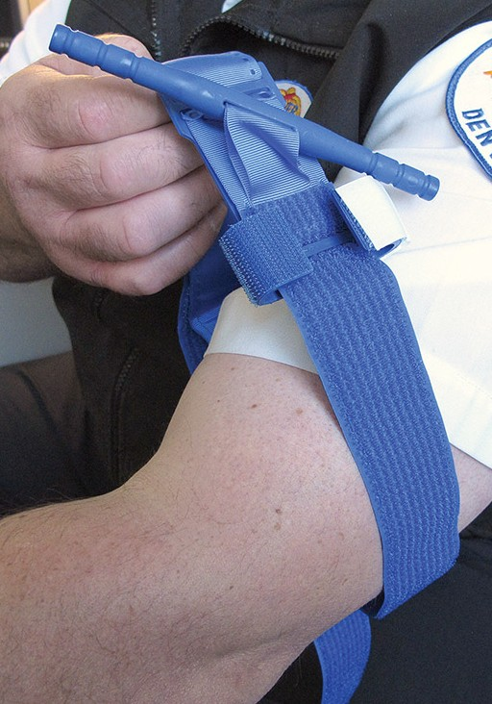
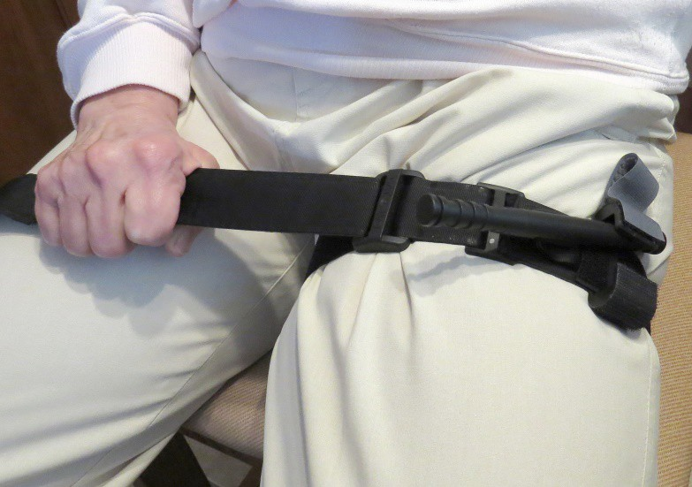
ABCs of Bleeding
Primary Principles:
C • Compression: Stop the Bleeding (continued)
Application of a C.A.T. Tourniquet (1 of 9)
Step 1. Insert the wounded
extremity (arm or leg) through the C.A.T.
Photo courtesy of Peter T. Pons, MD, FACEP.
Photo courtesy of Peter T. Pons, MD, FACEP.
Notes:
Note that these photos show the C-A-T™ tourniquet. It is important to become familiar with the device you will have access to if you have a different tourniquet.
The C-A-T™ tourniquet is available in three colors—black, blue and orange.
All three tourniquets are identical in every way except for the color.
The black tourniquet was designed for “tactical” applications, the orange tourniquet for “rescue” applications, and the blue tourniquet for training purposes.
Step 1: Open up the tourniquet and insert the wounded extremity (arm or leg) through the loop of the C-A-T™.

Slide 37
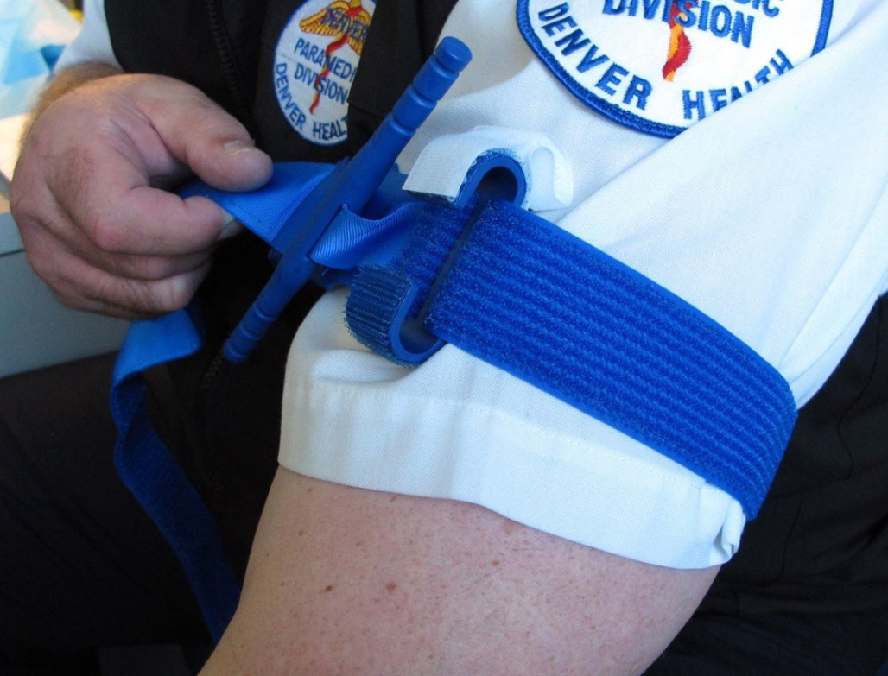
ABCs of Bleeding
Primary Principles:
C • Compression: Stop the Bleeding (continued)
Application of a C.A.T. Tourniquet (2 of 9)
Step 2. Pull the self-adhering band tight, and securely fasten it back
on itself.
BE SURE TO REMOVE ALL SLACK.
Photo courtesy of Peter T. Pons, MD, FACEP.
Notes:
Step 2: Pull the free end of the self-adhering band as tight as you possibly can and fasten it back on itself.
It is important that you remove all the slack out of the tourniquet in order for the tourniquet to function properly.

Slide 38
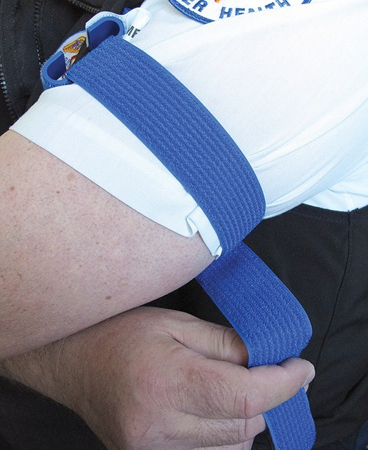
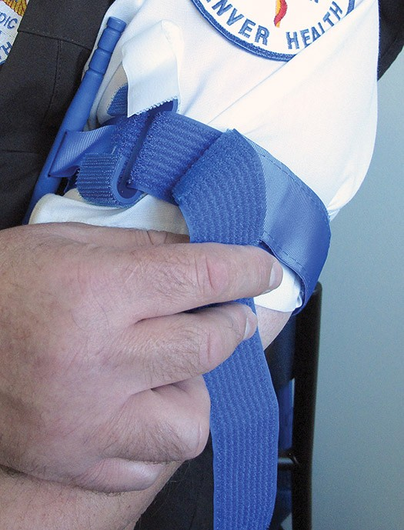
ABCs of Bleeding
Primary Principles:
C • Compression: Stop the Bleeding (continued)
Application of a C.A.T. Tourniquet (3 of 9)
Step 3. Adhere the band around the extremity. Do not adhere
the band past the clip.
Photo courtesy of Peter T. Pons, MD, FACEP.
Photo courtesy of Peter T. Pons, MD, FACEP.
Notes:
Step 3: Wrap the free end of the strap around the extremity and adhere the band to itself
Wrap it up to the clip on the tourniquet but don’t go past the clip.

Slide 39
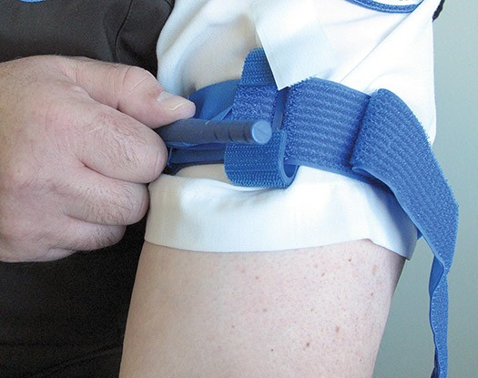
ABCs of Bleeding
Primary Principles:
C • Compression: Stop the Bleeding (continued)
Application of a C.A.T. Tourniquet (4 of 9)
Step 4. Twist the windlass rod until the bleeding has stopped.
Photo courtesy of Peter T. Pons, MD, FACEP.
Notes:
Step 4: Then, twist the windlass rod until the bleeding has stopped.
If you pulled it as tight as you could earlier in step 2 and removed all of the slack out of the tourniquet, it will take you no more than two to three 180 degree turns of the windlass to make it tight and stop bleeding.
If it is taking more turns than that, you probably did not remove enough of the slack when first pulling it tight.

Slide 40
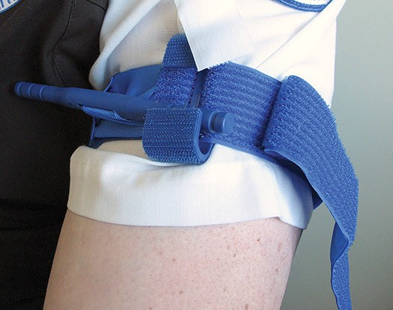
ABCs of Bleeding
Primary Principles:
C • Compression: Stop the Bleeding (continued)
Application of a C.A.T. Tourniquet (5 of 9)
Step 5. Lock the windlass rod in place in the windlass clip.
Bleeding is now controlled.
Photo courtesy of Peter T. Pons, MD, FACEP.
Notes:
Step 5: Lock the windlass rod in place by inserting it into the windlass clip.
The victim’s bleeding from that extremity should now be stopped.

Slide 41
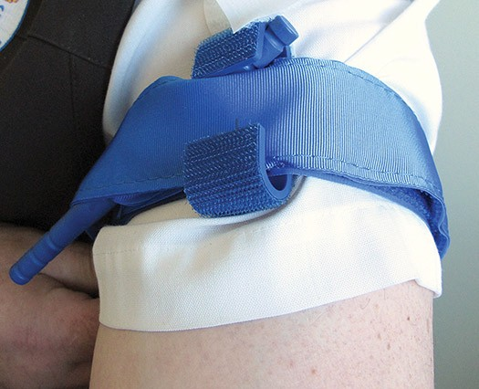
ABCs of Bleeding
Primary Principles:
C • Compression: Stop the Bleeding (continued)
Application of a C.A.T. Tourniquet (6 of 9)
Step 6. Adhere the remaining
self-adhering band over the rod, through the windlass clip, and
continue around the extremity as far as it will go.
Photo courtesy of Peter T. Pons, MD, FACEP.
Notes:
Step 6: Adhere the remainder of the long self-adhering strap over the windlass rod and place it through the windlass clip.
Continue to adhere it to itself around the extremity as far as it will go.

Slide 42
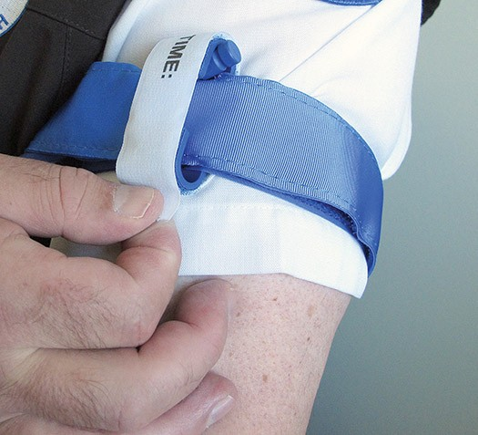
ABCs of Bleeding
Primary Principles:
C • Compression: Stop the Bleeding (continued)
Application of a C.A.T. Tourniquet (7 of 9)
Step 7. Secure the rod and the band with the windlass strap.
Grasp the strap, pull it tight, and adhere it to the opposite hook on the windlass clip.
Photo courtesy of Peter T. Pons, MD, FACEP.
Notes:
Step 7: Secure the rod and the band in place with the small windlass strap, which will usually be either white or gray in color and has the word “time” written on it.
Grasp the end of the windlass strap, pull it tight over the windlass clip, and adhere it to the opposite side hook on the windlass clip.
This will prevent the windlass from becoming dislodged when the victim is moved for transport.

Slide 43
ABCs of Bleeding
Primary Principles:
C • Compression: Stop the Bleeding (continued)
Application of a C.A.T. Tourniquet (8 of 9)
Step 8. Note the time the
tourniquet was applied. If you have a marker, you can write it directly on the tourniquet.
The patient is now ready for transport.
Photo courtesy of Peter T. Pons, MD, FACEP.
Notes:
Step 8: Finally, note the time that the tourniquet was applied.
If you have a marker or pen, you can write the time directly on the windlass strap of the tourniquet.
If you don’t have something you can use to write the time, you should still note the time that is was applied and then, when the medical responders arrive, verbally tell them what time you placed the tourniquet.
The patient is now ready to be transported to the appropriate hospital (trauma center).

Slide 44
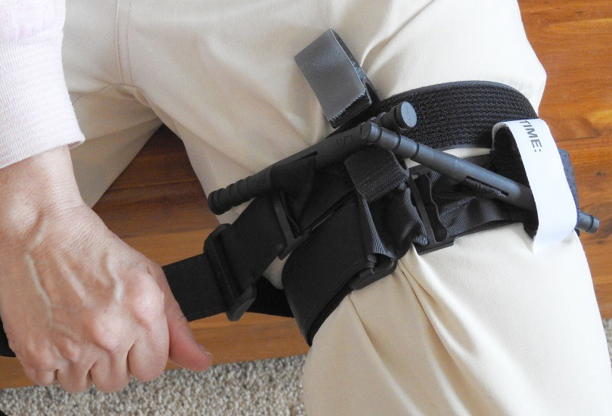
ABCs of Bleeding
Primary Principles:
C • Compression: Stop the Bleeding (continued)
Key Points (1 of 2)
Using one of the recommended tourniquets is a safe procedure
- Improvised (homemade) tourniquets are much less effective than
commercially available tourniquets such as the C.A.T. and are difficult to make and apply without extensive practice
If the bleeding is not stopped with one
tourniquet and it is as tight as you can get it,
place a second one, if available, just above the first and tighten as before
Introduction | Principles | A-Alert | B-Bleeding | C-Compression |
Notes:
Using one of the recommended tourniquets is a safe procedure.
Commercially available tourniquets are preferred over improvised tourniquets because improvised ones don’t work as well and are less effective.
If you apply the tourniquet and have made it as tight as possible and the bleeding is still not controlled, apply a second tourniquet. If one is available, apply it just above the first one and tighten as before. Two tourniquets will occasionally be required to stop bleeding, especially on a large leg or thigh.
If a second tourniquet is not available, apply pressure to the wound as described previously.

Slide 45
ABCs of Bleeding
Primary Principles:
C • Compression: Stop the Bleeding (continued)
Key Points (2 of 2)
No amputations have been caused by a tourniquet when left in place for fewer than two hours
  BUT… it is best to get the patient to a trauma center as soon as possible so the bleeding can be completely controlled and the tourniquet removed
Better to risk damage to the arm or leg than to have a victim bleed to death
Training (practice) tourniquets should NOT be used during a real patient incident
  Repetitive use during training exercises may cause the tourniquet to fail
Notes:
For many decades, tourniquets were not recommended for bleeding control. This was because most tourniquets were made of improvised materials and the success of this intervention was not reliable.
However, the experience obtained during the Iraq and Afghanistan conflicts has proven that an approved, commercially available tourniquet can be one of the most important lifesaving tools for wounds involving the extremities!
If it comes down to a choice between someone bleeding to death and the risk of damage to the arm or the leg, it is obviously better to leave the tourniquet in place and risk the damage to the arm or leg than to have them bleed to death.
Lastly, practice or training tourniquets should not be used during a real incident as the repeated use during practice may cause it to fail.
Training tourniquets should be labelled “training” as to not be confused with in-service equipment.

Slide 46
ABCs of Bleeding
Primary Principles:
C • Compression: Stop the Bleeding (continued)
Tourniquet Pain
Tourniquets HURT when applied effectively (they HURT A LOT)
- Explain this fact to the victim
Pain DOES NOT mean you put on the tourniquet incorrectly
Pain DOES NOT mean you should take the tourniquet off
Once paramedics arrive, they will treat the pain with medication
Notes:
When you apply a tourniquet and it is tight enough to stop bleeding, it hurts and it hurts a lot.
If you are placing a tourniquet on someone else, let them know that it is going to hurt.
Pain DOES NOT mean that you put the tourniquet on incorrectly or that you should take it off the patient.
Instead, reassure the victim that as soon as paramedic medical responders arrive, they will be able to treat the pain with medication to help relieve it.

Slide 47
ABCs of Bleeding
Primary Principles:
C • Compression: Stop the Bleeding (continued)
Common Mistakes
Not using a tourniquet or waiting too long to apply it when there is life-threatening bleeding
Not making the tourniquet tight enough to stop the bleeding
Not using a second tourniquet, if needed
Periodically loosening the tourniquet to allow blood flow to the injured extremity
  Causes unacceptable additional blood loss—DO NOT LOOSEN
Removing a tourniquet
  Only a paramedic or physician should loosen or remove it
Notes:
These are common mistakes made by first responders applying tourniquets.
- Not using a tourniquet when there is life-threatening bleeding and the patient continues to bleed
- Waiting too long to apply a tourniquet while the patient continues to bleed
- Using a tourniquet for minor bleeding.
While this is a mistake, if you are not sure if the bleeding is life-threatening or not, it is better to apply the tourniquet than to allow
someone to continue to bleed.
In most cases, it will be on for only a short period of time until a trained medical responder can evaluate the victim and determine the need to keep it on.
In past first aid classes it used to be taught that if you placed a tourniquet on an extremity, you should loosen it every 15-20 minutes. The thinking was that this would let blood back into the arm or leg and keep it alive longer.
DO NOT DO THIS. By loosening the tourniquet, you just allow more blood to leak out of the wound. This is dangerous and is bad for the victim.

Slide 48
ABCs of Bleeding
Primary Principles:
C • Compression: Stop the Bleeding (continued)
Questions about
tourniquets?
Notes:
Pause for any questions related to tourniquet use….

Slide 49
ABCs of Bleeding
Primary Principles:
C • Compression: Stop the Bleeding (continued)
Tourniquet Practice
Notes:
Every participant in the course should be given the opportunity to apply the tourniquet to themselves and on both the arm and the leg. Instructors should watch for proper adherence to placement technique.
Instructor Note: You can pause at this point in order to allow students to practice tourniquets, or you can complete the entire lecture portion of the course and have the group practice both skills (tourniquets and wound packing) after the lecture.
It is critical that students get ‘hands-on” exposure to both skills before completing the course.

Slide 50
ABCs of Bleeding
Primary Principles:
C • Compression: Stop the Bleeding (continued)
?
Is a tourniquet available immediately?
Ensure your safety.
Look for life-
Is a trauma first-aid kit
Where is the
threatening bleeding.
wound?
Arm or leg
available?
Yes
Notes:
Now let’s discuss what to do if a trauma kit does not contain a tourniquet.

Slide 51
ABCs of Bleeding
Primary Principles:
C • Compression: Stop the Bleeding (continued)
?
Is a tourniquet available immediately?
Ensure your safety.
Look for life-
Is a trauma first-aid kit
Where is the
threatening bleeding.
wound?
Arm or leg
available?
Yes
No
Notes:
In this case, the wound is still on an extremity but a tourniquet is not immediately available.

Slide 52
ABCs of Bleeding
Primary Principles:
C • Compression: Stop the Bleeding (continued)
?
Is a tourniquet available immediately?
Ensure your safety.
Look for life-
Is a trauma first-aid kit
Where is the
threatening bleeding.
wound?
Arm or leg
available?
Yes

Use hemostatic (bleeding control) gauze (preferred) or any gauze or clean cloth.

Apply continuous, direct pressure.
No
Notes:
If a tourniquet is not available but a bleeding control gauze (also known as a hemostatic dressing) is available, the gauze should be packed or stuffed into the wound and then pressure applied directly on the wound.
If a bleeding control gauze is not available, then any clean cloth or plain gauze along with direct pressure can be used as described before.

Slide 53
ABCs of Bleeding
Primary Principles:
C • Compression: Stop the Bleeding (continued)
?
Is a tourniquet available immediately?
Ensure your safety.
Look for life-
Is a trauma first-aid kit
Where is the
threatening bleeding.
wound?
Arm or leg
available?
Yes

Use hemostatic (bleeding control) gauze (preferred) or any gauze or clean cloth.

Apply continuous, direct pressure.
Neck, shoulder, groin
No
Notes:
If the wound instead is located in one of the junctional areas (the neck, shoulder, armpit or groin) and a bleeding control gauze is available, the gauze should be packed or stuffed into the wound and then pressure applied directly on the wound.
If a bleeding control gauze is not available, any clean cloth or plain gauze along with direct pressure can be used as described before.

Slide 54
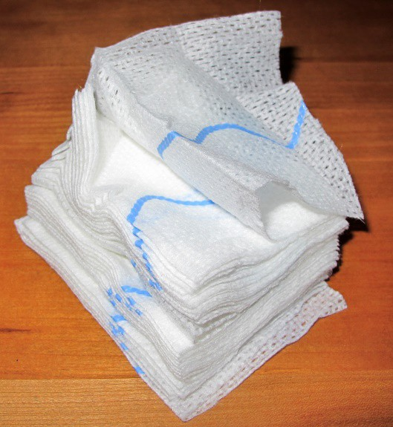
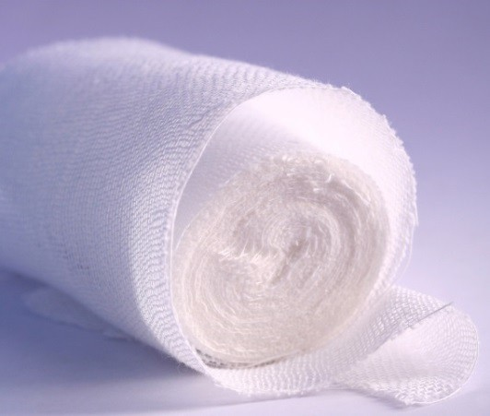
ABCs of Bleeding
Primary Principles:
C • Compression: Stop the Bleeding (continued)
Hemostatic Dressings (Bleeding Control Dressings)
Hemostatic dressings are materials that help cause blood to clot
Examples of hemostatic dressings include:
  QuikClot (civilian) /
Combat Gauze (military)
  Celox
  Celox Rapid
  Chitoflex
  Chitogauze
© emily2k/ShutterStock, Inc.
Photo courtesy of Peter T. Pons, MD, FACEP.
Notes:
The word hemostatic is a medical term that means “ stopping the flow of blood”.
Hemostatic dressings are usually gauze rolls that have been impregnated with a material or substance that will help blood clot.
This slide lists the most commonly available hemostatic products currently available on the market.

Slide 55
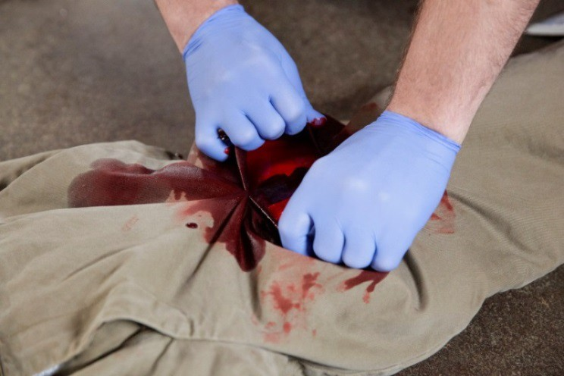
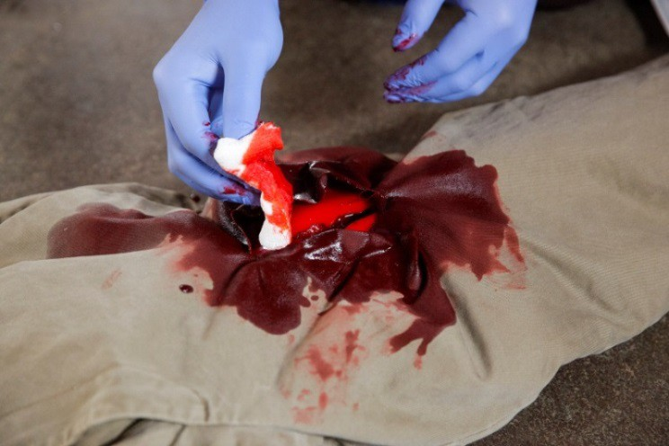
ABCs of Bleeding
Primary Principles:
C • Compression: Stop the Bleeding (continued)
Wound Packing (1 of 5)
Open clothing around the wound
If possible, remove excess pooled blood from the wound while preserving any clots already formed in the wound
Locate the source of the most active bleeding
© Jones & Bartlett Learning. Photographed by Darren Stahlman.
© Jones & Bartlett Learning. Photographed by Darren Stahlman.
Notes:
Let’s go over the steps for packing a wound with a hemostatic dressing or gauze roll or even a clean cloth.
First you have to locate the wound…so open clothing over the wound to expose it.
If you see a lot of pooled blood around the wound, remove it from the wound by gently wiping it away.
If there are any visible clots in the wound, try to avoid dislodging them if possible.
Then look into the wound and try to find the point where it is bleeding from.
Even large wounds typically only have one or two places that are actively bleeding
Locate the source of the most active bleeding

Slide 56
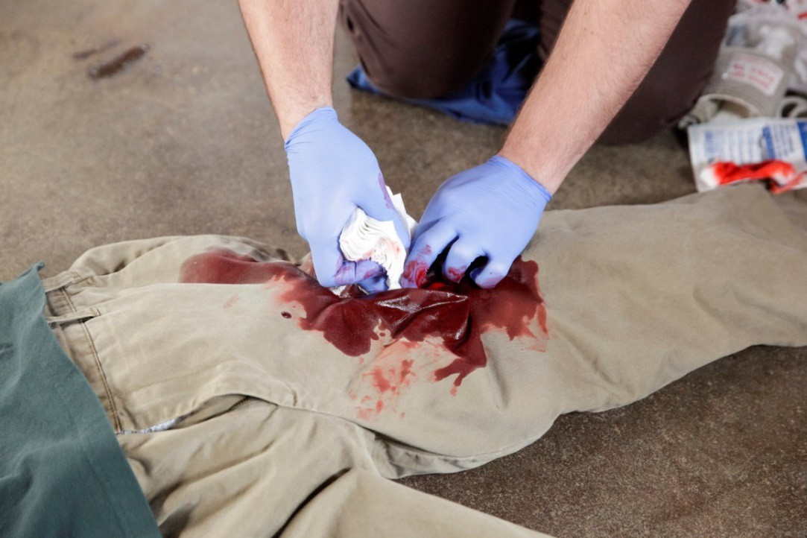
ABCs of Bleeding
Primary Principles:
C • Compression: Stop the Bleeding (continued)
Wound Packing (2 of 5)
Pack the wound
  Hemostatic dressing, OR
  Gauze roll, OR
  Clean cloth
Stuff right into the wound and directly onto the bleeding site
© Jones & Bartlett Learning. Photographed by Darren Stahlman.
Notes:
Then, pack or stuff the hemostatic or plain gauze or clean cloth directly into the wound, down into the bottom of the wound and right onto the point of bleeding.

Slide 57
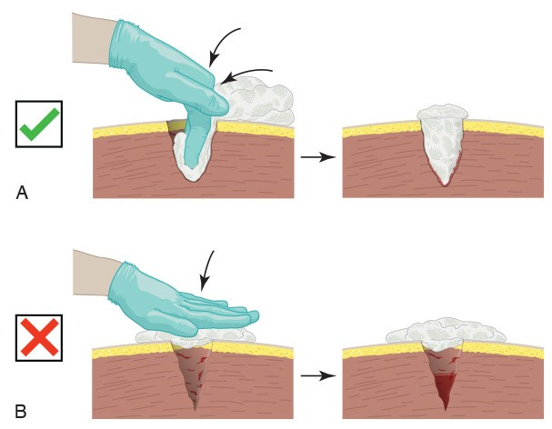
ABCs of Bleeding
Primary Principles:
C • Compression: Stop the Bleeding (continued)
Wound Packing (3 of 5)
Notes:
The top image shows the correct way to pack the wound. The packing material is stuffed down deep into the base of the wound, as close as possible to the actual source of the bleeding.
The lower image shows the incorrect way to pack a wound. If the wound is not packed properly, pressure cannot be applied to the actual bleeding site and the bleeding will continue.

Slide 58
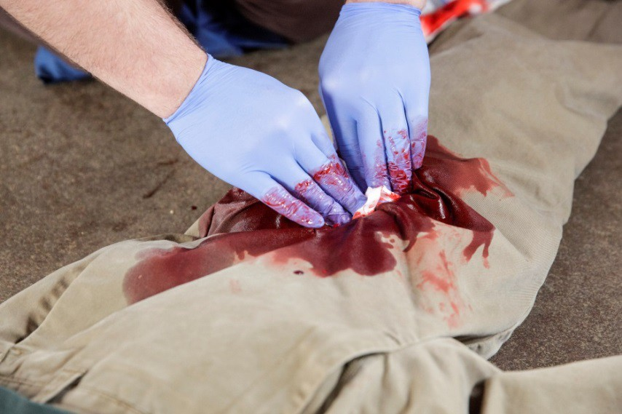
ABCs of Bleeding
Primary Principles:
C • Compression: Stop the Bleeding (continued)
Wound Packing (4 of 5)
Quickly apply and hold pressure directly on the packed wound until relieved by medical responders
If initial packing and direct pressure
fail to stop the bleeding, pack a second gauze on top of the first and reapply
pressure using increased force
© Jones & Bartlett Learning. Photographed by Darren Stahlman.
Notes:
Once you have packed the entire dressing into the wound, apply and hold firm pressure using both hands.
By packing the wound, when you apply pressure, that pressure is transmitted down to the bottom of the wound toward the source of the bleeding. The packing will also help to form a clot along with the pressure you are putting on the wound.
It is best to keep holding pressure on the wound until you are relieved by medical responders.
If you note that the packing you placed has become completely soaked with blood and the wound is continuing to bleed, take a second roll of gauze and pack it right on top of the first one and reapply pressure.

Slide 59
ABCs of Bleeding
Primary Principles:
C • Compression: Stop the Bleeding (continued)
Questions about wound packing
and direct pressure?
Notes:
Pause for questions about wound packing or the application of direct pressure.

Slide 60
ABCs of Bleeding
Primary Principles:
C • Compression: Stop the Bleeding (continued)
Wound Packing Practice
Notes:
Every participant should be allowed an opportunity to pack a wound using a wound packing model.

Slide 61
Bleeding control in children
In all but the extremely young child, the same tourniquet used for adults can be used in children.
For the infant or very small child (tourniquet too big), direct pressure on the wound as described previously will work in virtually all cases.
For large, deep wounds, wound packing can be performed in children just as in adults using the same technique as described previously.
Notes:
Techniques to control bleeding in the child are very similar to what has been presented for adults.
As long as they can be properly applied, the same tourniquet can be used in an adult or a child.
If the child is too small for the tourniquet to be applied properly, direct pressure on the bleeding wound will almost always work to control the bleeding.
Wound packing is the same in both adults and children.

Slide 62
Blood Exposure
After arrival of medical responders, if you have any blood on you:
  Wash thoroughly with soap and water to remove all blood,
  AND
  Notify medical responders of possible exposure
Notes:
Exposure to blood is not uncommon in these situations.
While the overall risk of disease transmission is low, it always a possibility.
Once you have been relieved by the responding medical personnel, you should immediately and thoroughly wash the exposed area with soap and water to remove all blood. Then inform the medical responders that you did get some of the victim’s blood on you so they can take appropriate steps to notify the receiving hospital of the exposure and evaluate the victim and you for potential infectious diseases.

Slide 63
Summary
Ensure your own safety
The ABCs of Bleeding
A – Alert – call 9-1-1
B – Bleeding – find the bleeding injury
C – Compress – apply pressure to stop the bleeding by:
  Covering the wound with a clean cloth and applying pressure by pushing directly on it with both hands, OR
  Using a tourniquet, OR
  Packing (filling) the wound with gauze or a clean cloth and then applying pressure with both hands
Notes:
To summarize everything that we have talked about…
First, you must be sure that the scene is safe for you to assist the victim without risking injury to yourself. You do not want to become a trauma victim yourself.
Let’s review the ABCs of bleeding once again:
A – Alert – either call 9-1-1 or the local emergency number yourself or direct someone to do so. This will ensure that trained help is on the way along with law enforcement, depending on the situation.
B – Bleeding – locate the victim’s wound and determine if there is life-threatening bleeding coming from the wound. This will often mean opening up the clothing and exposing some of the patient so you can see the wound.
C – Compression – do what you can to stop the bleeding. This usually means compressing the bleeding blood vessel, either directly using two hands, using a tourniquet on an arm or a leg placed above the wound to compress the artery, or by packing the bleeding wound and then applying pressure on it with both hands.

Slide 64
Conclusion
The only thing more tragic than a death…
is a death that could have been prevented.
Thank you for your participation.
Questions?
Notes:
Thank your participants for their interest and attention.
Solicit the group for any questions one last time.

Slide 65
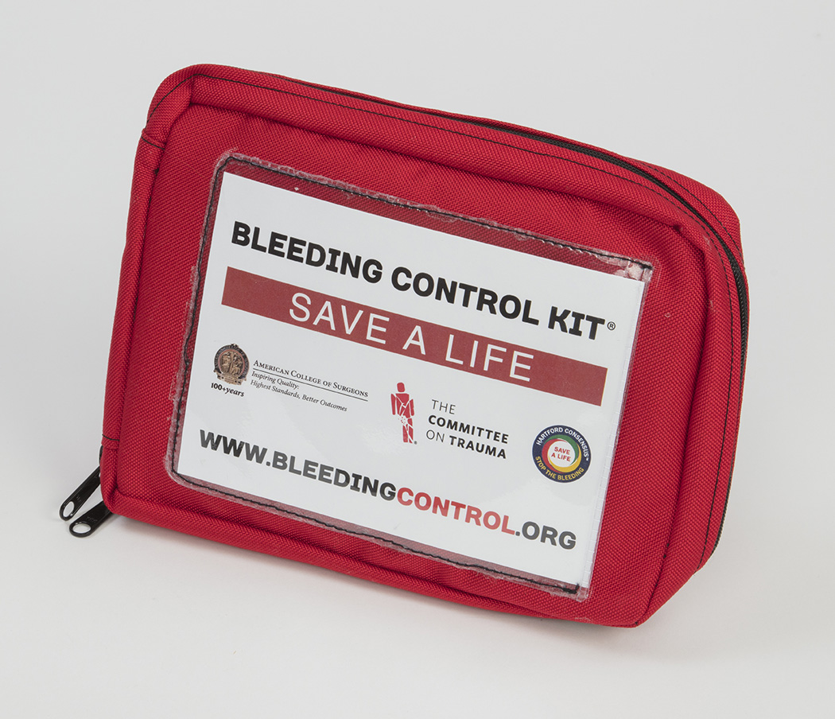
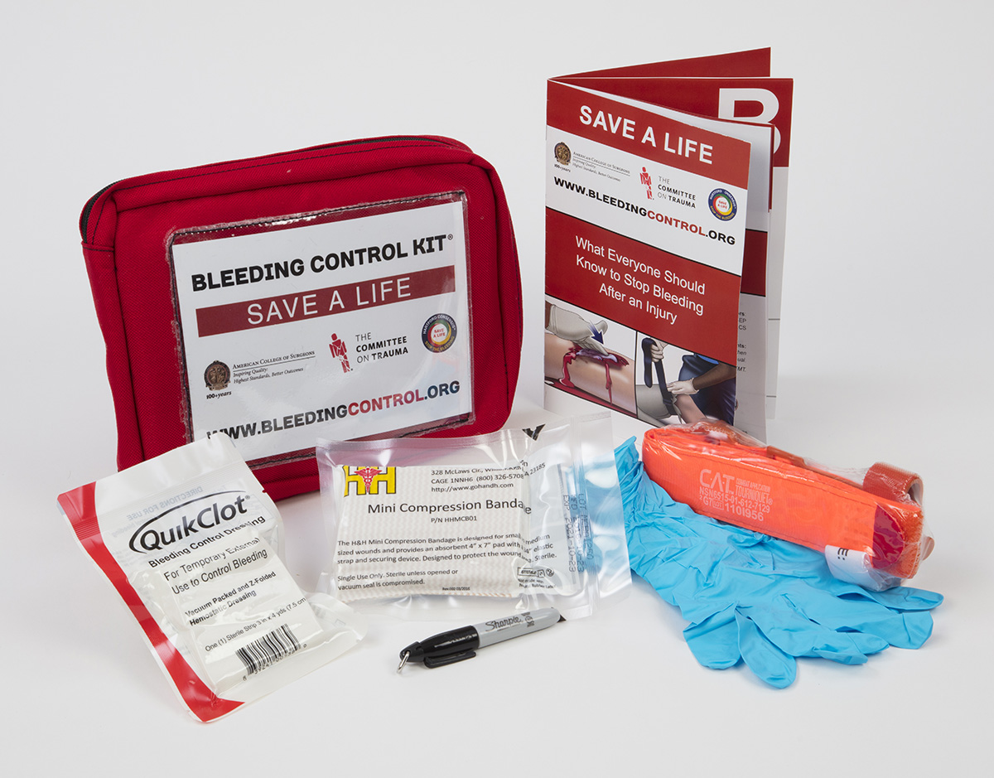
Personal bleeding control kits
Notes:
Closing thoughts:
Encourage participants to advocate for the placement of bleeding control kits in areas they are concerned about. This will vary based on the composition of the class, but may involve purchasing small kits for personal or home use …...

Slide 66
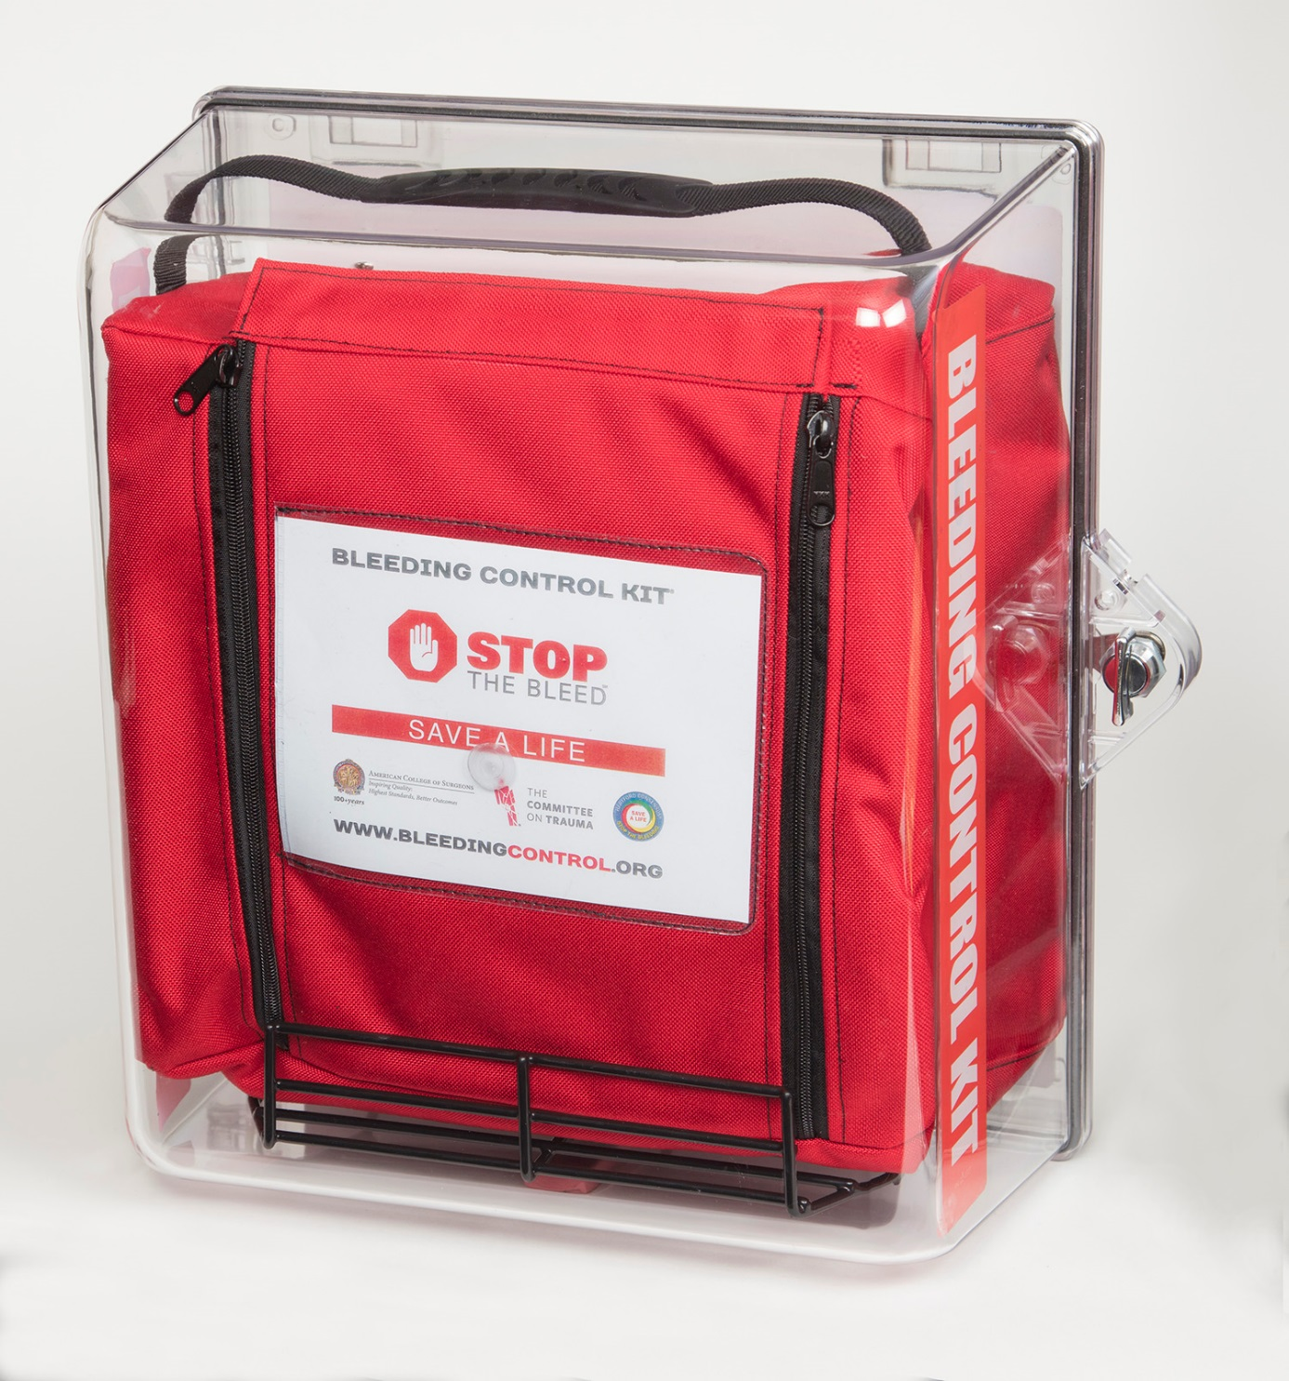
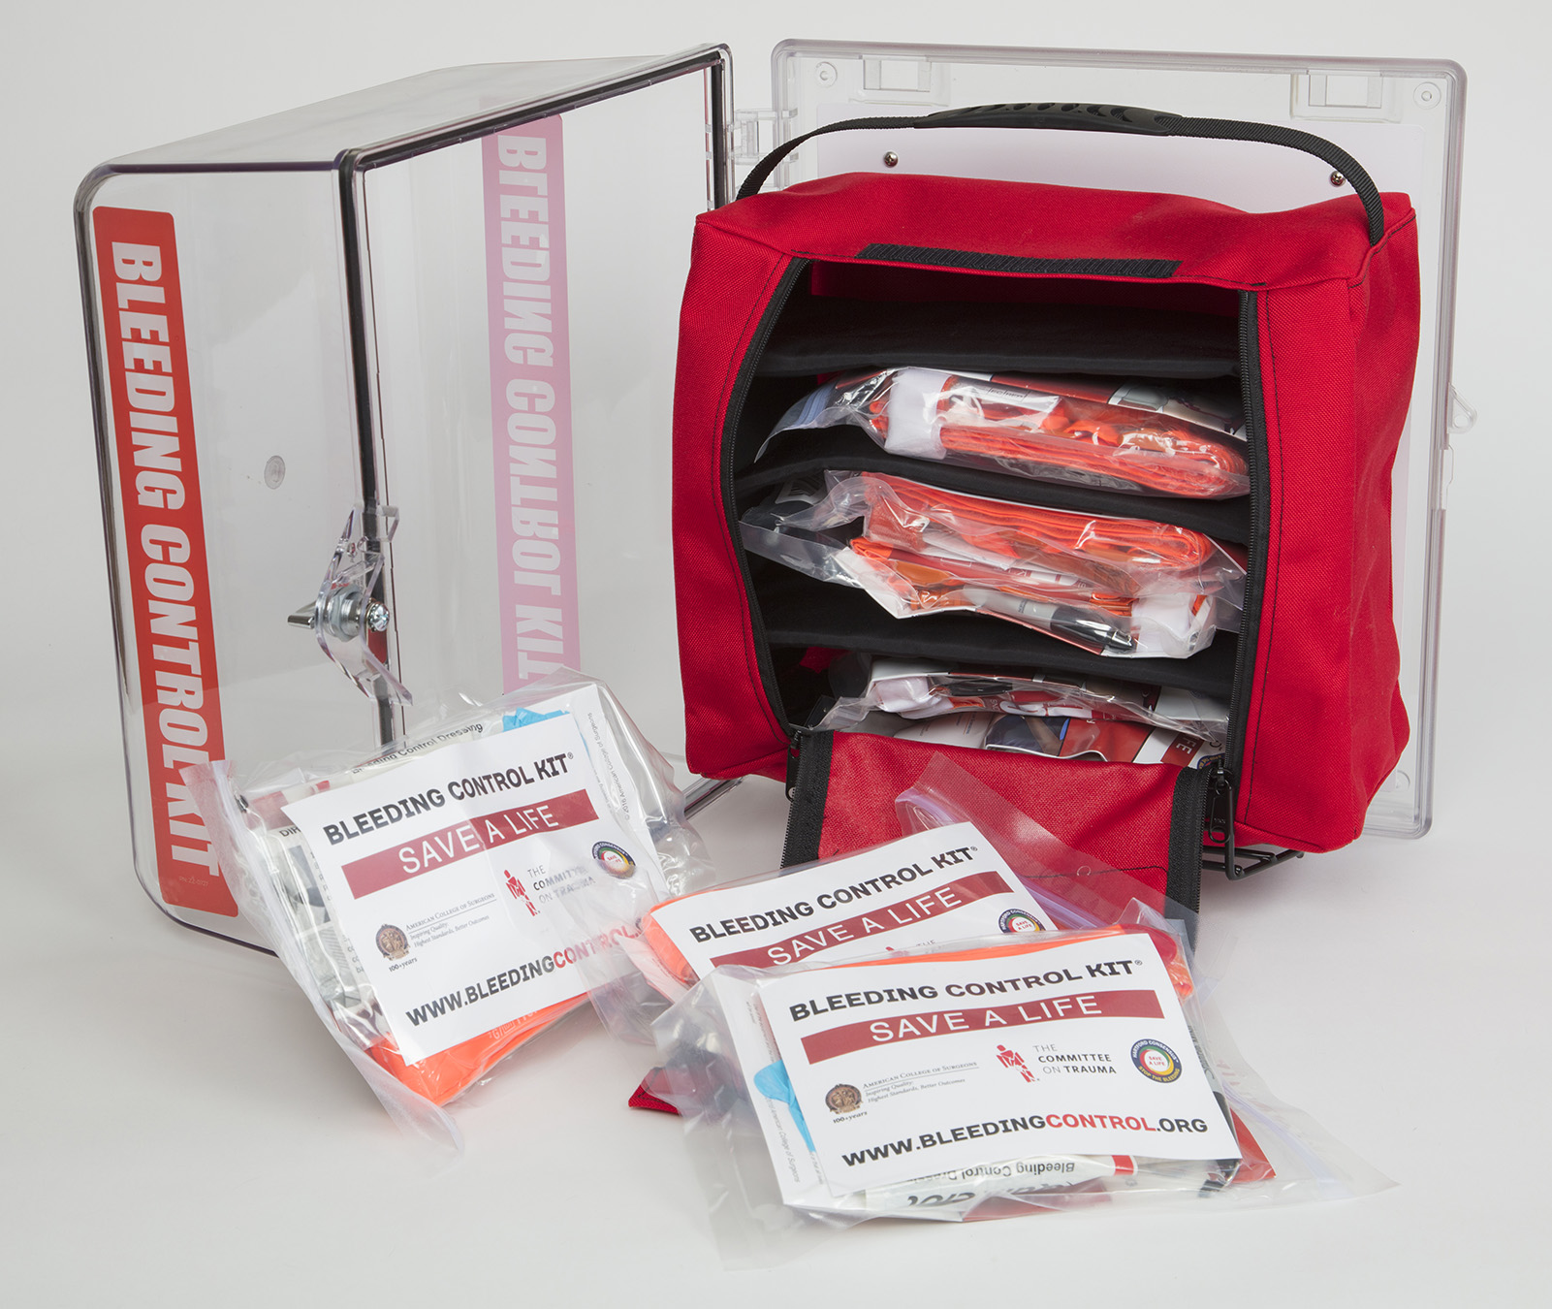
Wall-mounted bleeding control kits
Notes:
Closing thoughts:
… or larger kits for public spaces such as sporting venues, churches, schools and other areas where people come together.

Slide 67
For further information and additional resources, please visit
BLEEDINGCONTROL.ORG
Notes:
Lastly….
Encourage participants to visit bleedingcontrol.org. This site is maintained by the American College of Surgeons and is updated frequently with new information regarding this important topic.

