Slide 1
2026 ENA Overview
Licensed EMS Providers
Grace Threadgill, B.S.Ed.
Trauma System Development Intern
EMS Committee Meeting
April 9th, 2026
Notes:
Good morning! It’s wonderful to see everyone here today – thank you for the opportunity to present to you directly!
I’m Grace Threadgill – an MPH candidate with UGA’s College of Public Health and Trauma System Development Intern under Crystal Shelnutt.
I’m very excited to share a little bit of what I learned about the educational needs of Licensed EMS Providers who responded to the 2026 Educational Needs Assessment Survey this Spring.
Let’s get into it!
(next slide)

Slide 2
Survey Response Summary (N=373)
62% serve in Regions 7, 8, 9, and 10.
53% are certified Paramedics.
42% have 15+ years of experience.
46% are EMT, EMT-I, and AEMT certified.
32% have 3-10 years of experience.
Notes:
I’d like to begin with a summary of ENA survey response demographics for your Licensed EMS Providers for 2026.
There were 373 total EMS Providers who responded to our survey this past February – which was only about a third of the providers who responded last year.
The majority of responses came from Regions 7 through 10.
- 62% reported from EMS Regions 7, 8, 9, and 10
followed by 24% from Regions 1, 2, and 3
and 15% in Regions 4, 5, and 6.
53% were certified Paramedics -- and 46% were EMT-, EMT-”I”-, and AEMT-certified.
42% of respondents had 15+ years of experience in the field – and 32% had 3-10 years of experience.
Overall, you’ll find that the majority those who responded to the survey this year served in Regions 7, 8, 9, and 10, were certified Paramedics, and were moderately to highly experienced on the job as Licensed EMS Providers.
NEXT SLIDE

Slide 3

Trauma Skill Training Needs (N=373)
47%
had limited confidence in their ability to respond to MCIs.
25%
had limited confidence in their ability to manage a critical trauma patient.
99%
reported simulation courses as helpful and beneficial to their CE.
Notes:
Next, I would like to highlight EMS Providers’ top trauma skill training needs.
The majority of respondents reported need for the skills highlighted in red on the graph:
pediatric trauma most of all (69%)
burn care (64%)
MCIs (63%)
trauma resuscitation (63%)
Providers emphasized MCIs as a specific area of concern, with 47% feeling somewhat confident to not confident at all in their ability to respond to multi-causality incidents.
----------
Around half of respondents reported need for skills highlighted in yellow on the graph:
Trauma arrest management (55%)
Advanced Airway Management (50%)
Needle Decompression (47%)
Blood Administration (45%)
Overall, a good three quarters of EMS Provider respondents felt confident in their ability to manage a critical trauma patient in the field with their current skills training.
The remaining 25% had limited confidence in their ability to manage a critical trauma patient, and I do want to emphasize that this statistic was fairly spread across years of experience, certification level, and EMS region.
EMS Providers also specifically felt that SIMULATION TRAINING was worthwhile to their skills training overall – with 99% reporting these trainings as helpful and beneficial to their continuing education in the Georgia Trauma System.
NEXT SLIDE

Slide 4
Barriers to Training Access and Attendance (N=373)
Personal Barriers
Logistical Barriers
System Barriers
39% reported financial limitations.
67% reported time constraints.
33% reported limited course availability.
Notes:
EMS Providers reported Personal, Logistical, and System-level Barriers that impact access and attendance to continuing education courses offered by GTC.
39% of providers reported personal financial limitations which often prevents basic access to the courses and training themselves.
67% reported logistical time constraints which makes attending the courses that they are able to sign up for more challenging and burdensome.
33% reported limited course availability as a system-wide barrier that impacts course access and attendance altogether.
NEXT SLIDE

Slide 5
Preferred Training Delivery (N=373)
Format
In-Person Class Duration
Travel Time
Training Type
Notes:
Finally, I want to point out some preferred training delivery methods that your providers reported this year.
A MAJORITY of EMS Providers preferred in-person delivery of in-house classes, skill workshops, and tutorials.
They preferred that these course run up to a half or full day and are within 1- or 2-hour travel distance if necessary.
74% preferred in-person classes over virtual delivery.
93% preferred half-day or full-day instructional sessions.
71% were willing to drive up to 1 hour to attend classes in person, with an additional 21% willing to drive up to 2-hours out of town.
Finally, 71% reported in-house classes, and 59% reported skill workshops and tutorials as their preferred type of training.
I’d like to wrap up my presentation with some personal suggestions from your providers for training in additional areas that weren’t specifically mentioned in the ENA survey:
Trauma pharmacology - medication and dosing math
Practical trainings – such as Cadaver labs, simulation training
Wilderness-specific courses
Extended duration trauma care
PHTLS, TECC
NEXT SLIDE - I really appreciate your time and attention this morning! I will pass things off to Mrs. Nicolle Sorta-Reyna – Thank you!

Slide 6
2026 ENA Overview
EMS Leadership
Tolulope Adedipe
Trauma System Development Intern
EMS Committee Meeting
April 9th, 2026
Notes:
Good morning! It’s wonderful to see everyone here today – thank you for the opportunity to present to you directly!
I’m Grace Threadgill – an MPH candidate with UGA’s College of Public Health and Trauma System Development Intern under Crystal Shelnutt.
I’m very excited to share a little bit of what I learned about the educational needs of Licensed EMS Providers who responded to the 2026 Educational Needs Assessment Survey this Spring.
Let’s get into it!
(next slide)

Slide 7
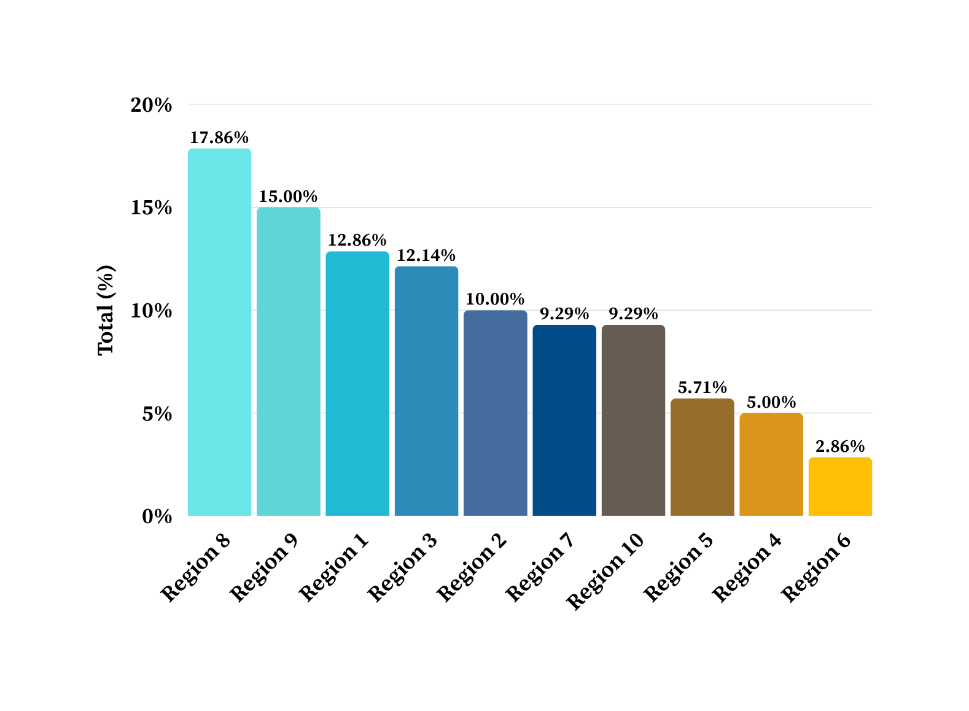
DEMOGRAPHICS: REGIONAL PARTICIPATION LEVELS
N = 140
Highest Participation levels in Regions 8, 9, & 1
.
Lowest Participation levels in Regions 5, 4, & 6

Slide 8
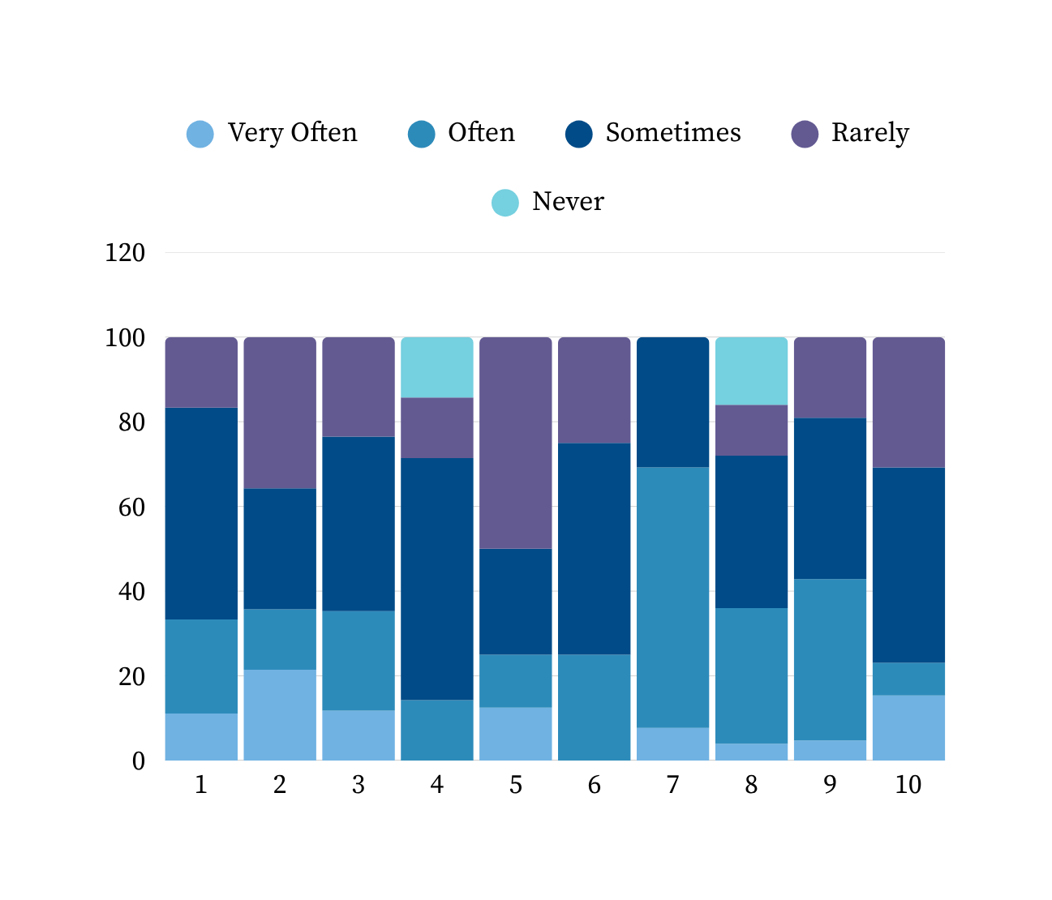
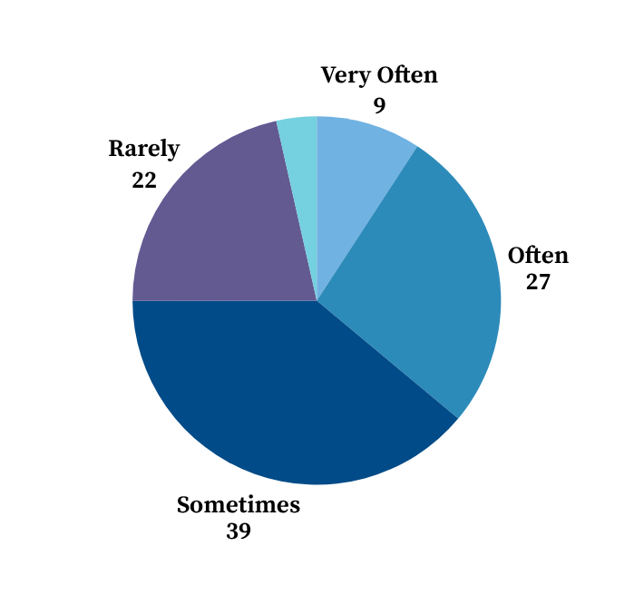
FREQUENCY OF CHALLENGES IN DELIVERING EDUCATION
Percent of participants reporting frequency of education delivery
Notes:
When asked how often they face challenges in delivering trauma education, most participants responded ‘somewhat’ or ‘often,’ and this trend was consistent across regions. This indicates that the barriers to effective training are widespread and not limited to a single area.
“Sometimes” Is the Most Common Frequency
Across regions, the majority of responses fall in the “Sometimes” category (25–57%), showing that challenges are regular but intermittent rather than constant.
Region 7 stands out with 62% reporting “Often,” suggesting higher training delivery difficulties.
Region 5 has 50% “Rarely,” indicating comparatively fewer obstacles.

Slide 9
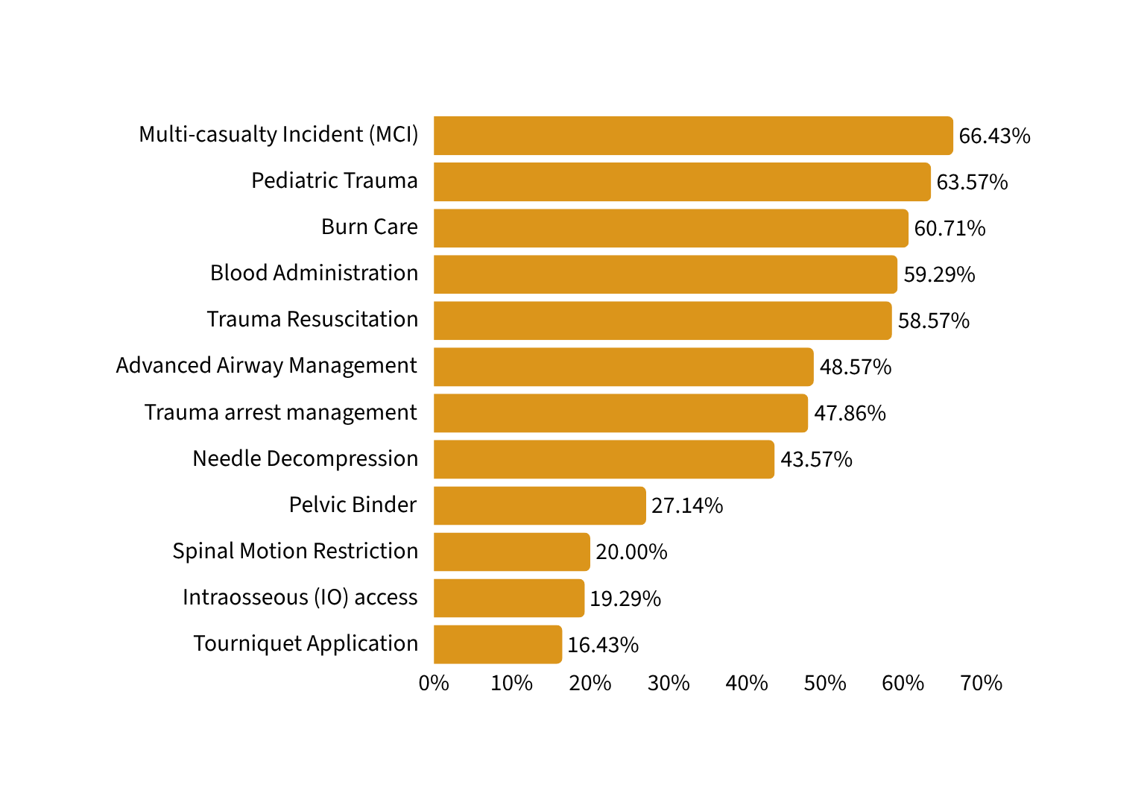
TOP TRAINING NEEDS ACROSS ALL REGIONS
MCI and trauma-related skills dominate overall training demand
Top skills represent the majority of identified gaps
Lower-ranked skills may be better suited for targeted/regional training
Regional data shows these needs often occur in combination, reinforcing the need for bundled training approaches.
Notes:
Training demand is concentrated in a small set of high-impact skills, which creates an opportunity for focused, system-wide curriculum design.

Slide 10
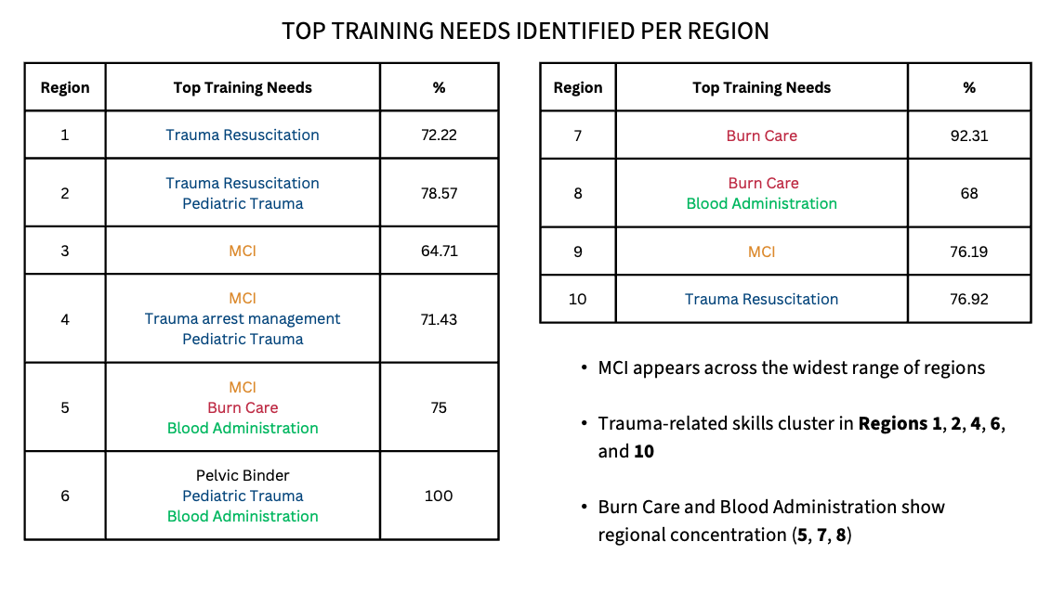

Slide 11
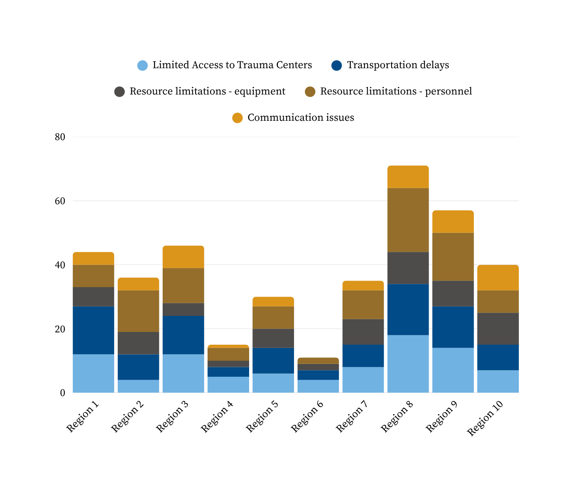
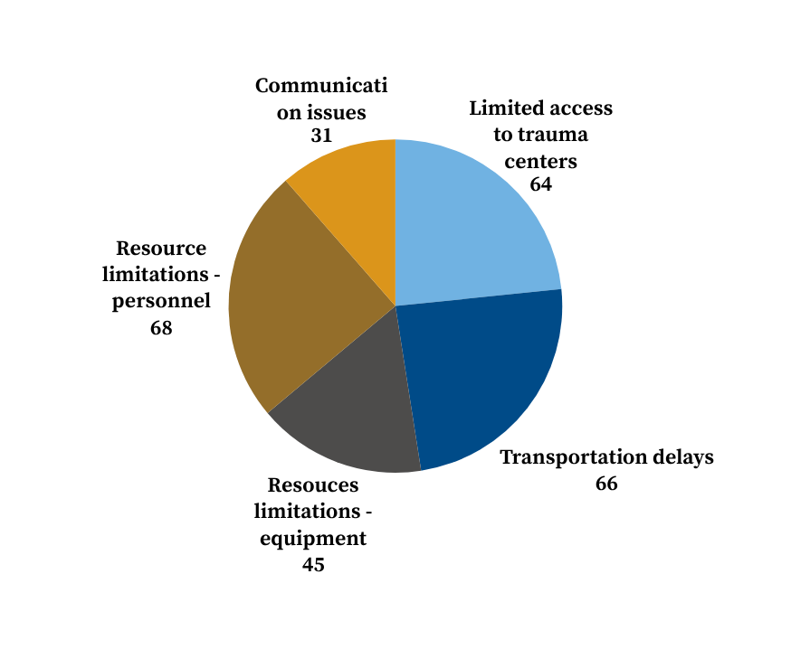
KEY CHALLENGES IN TRAUMA RESPONSE (BY REGION)
Percent of participants reporting barriers to effective trauma care
Notes:
When asked about challenges responding to trauma incidents in rural areas, participants most frequently cited personnel shortages, transportation delays, and limited access to trauma centers.
Most frequently reported challenges across regions are staffing shortages and limited equipment, with the highest counts in Regions 8, 9, and 2
Transportation issues are reported across almost all regions, particularly Regions 1, 8, and 9.
Highest counts are in Regions 8, 9, 1, and 3, suggesting structural gaps in access to trauma facilities.
Overall, communication issues were reported less often.
This pattern was generally consistent across regions, emphasizing that EMS leadership believes that especially resource limitation are the main obstacles for trauma response among EMS providers.

Slide 12
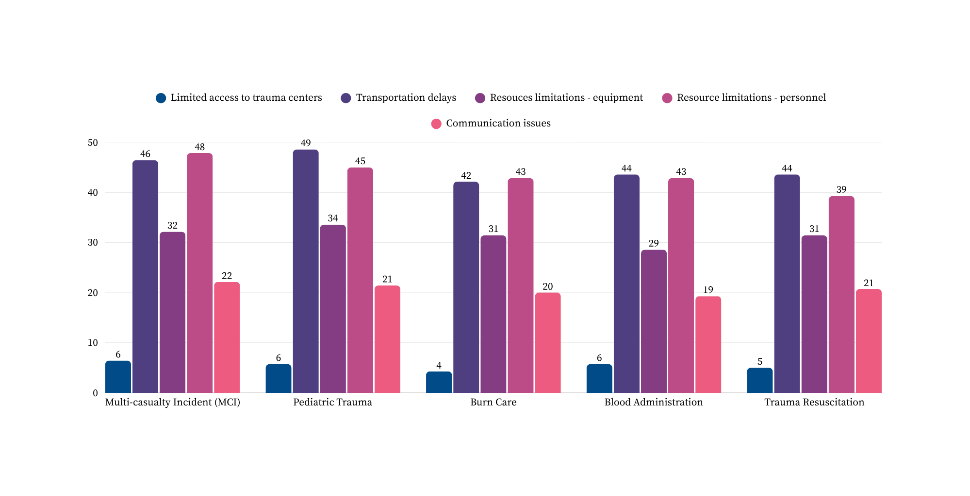
TRAUMA RESPONSE CHALLENGES AND CORRESPONDING SKILLS GAPS
Skill delivery is most strongly affected by Transportation Delays and Personnel & Equipment Limitations
Notes:
As previously stated, these five skills consistently emerged as high-priority training needs.
The skills participants identified as most critical closely reflect the operational barriers they face, especially shortages in personnel and equipment.
Focusing on these areas will have the greatest system-wide impact.

Slide 13
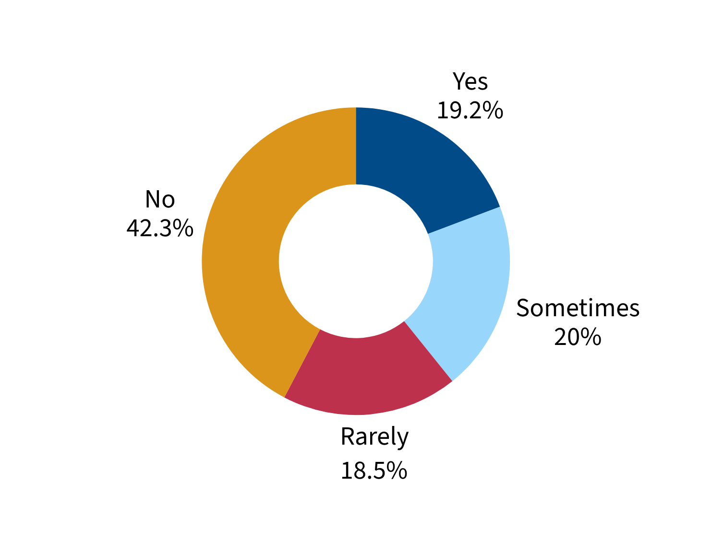
SUPPORT VS. ACCESS TO REGIONAL SIMULATION ASSETS
92.86% support having access to regional simulation assets for EMS Agency use
Notes:
Overall, our findings indicate that across all regions, trauma training needs are strongly influenced by system-level challenges such as staffing, equipment, transportation, and access to trauma centers.
Multi-Casualty Incidents, Pediatric Trauma, Burn Care, Trauma Resuscitation, and Blood Administration emerged as the highest-priority skills, with variation across regions highlighting the need for targeted support. Most importantly, recent grants provide concrete solutions by supporting training access, staffing, equipment, and regional trauma infrastructure, directly addressing these challenges and maximizing the impact of trauma education and response across all regions.

Slide 14
2026 EMS Needs Assessment Overview
Hospital Providers
Nicolle Sorto-Reyna, MPH Candidate
GTC Intern
14

Slide 16
ED Nurses (n=18) and Trauma Program Coordinators (n=11)

Slide 17
60% Satisfactory with EMS pre-arrival communication

Slide 18
Often (n=29) and Sometimes (n=13)
Often (n=24) and Sometimes (n=15)

Slide 21
Key opportunities include expanding education (especially pediatric and advanced trauma care), strengthening hospital–EMS collaboration, and improving feedback and outreach, while recognizing strong EMS dedication and ongoing improvement.
“EMS providers benefit greatly from hands-on training and consistent communication.”
“There is a meaningful opportunity… to increase trauma-specific feedback, joint education, and outreach.”
“Include EMS in debriefs for major traumas.”

Slide 22
Thank you!
Questions?

